Slide 1
A Direct-to-Consumer Platform and a Modern Brand Approach - Growing Your Market by Reaching New Consumers
Dr Adrian Gilbane
Co-Founder

Slide 2
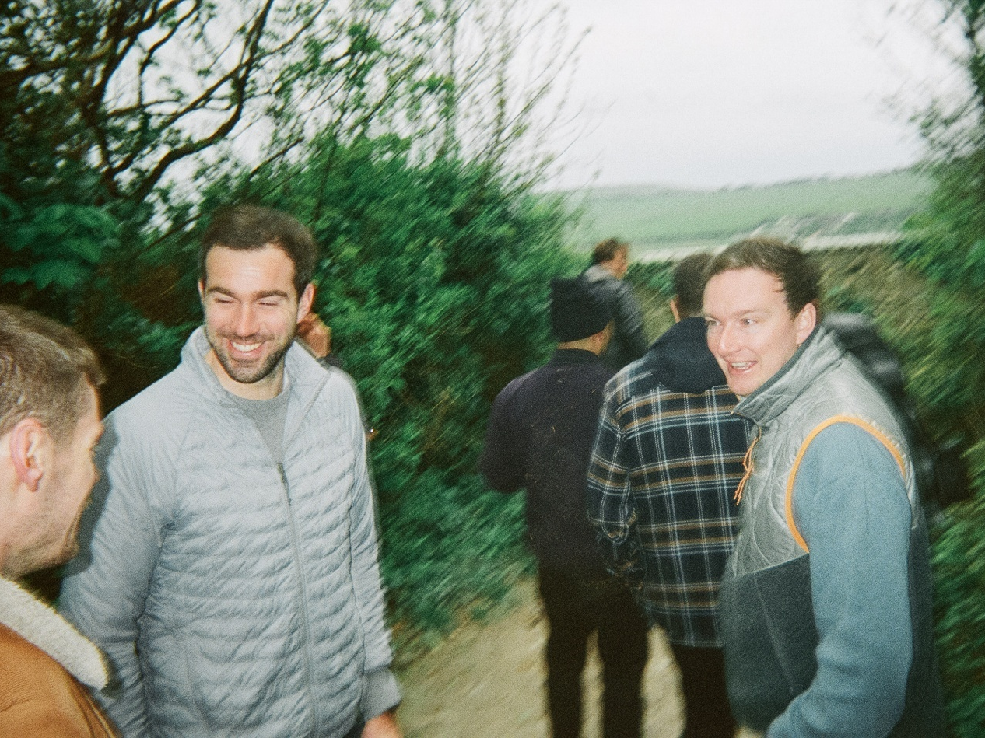
Sons’ is digital native brand focused on hair loss and scalp health
Sons’ was founded after a lived experience of founders, Will and Adrian, and their desire to help people become happier, hairier and healthier
Our Story
Sons’ co-founders Will and Adrian became increasingly aware that losing their hair was a possibility.
Over a drink, they realised –they had the right experience to start a company that helps men understand the facts about their health and motivates them to be more proactive in tackling their problems.
Sons is bringing men’s health and well-being into the 21st Century. Less stigma, clearer information, more convenience, better results.
Notes:
Talk about founding story
Set up in 2019 , Two friends
Went to Belgravia Clinic – was a non medical consult, non branded meds, poor education and expensive
Commercial entity in 2020, started as a digital D2C business, now multichannel in the UK, Ireland and Germany

Slide 3
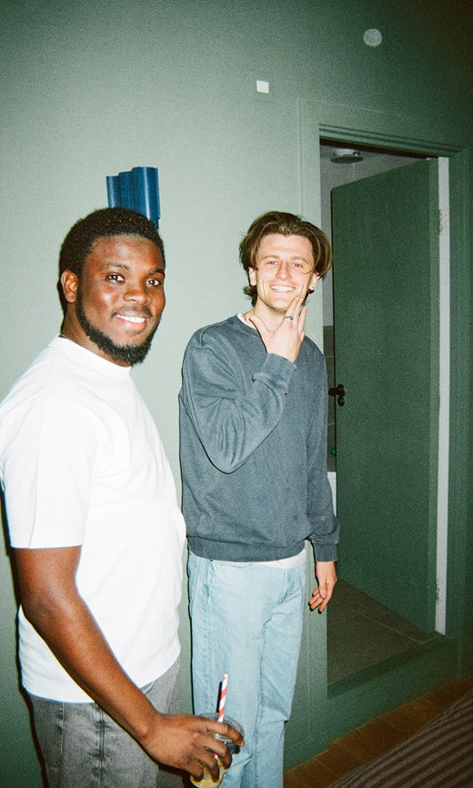

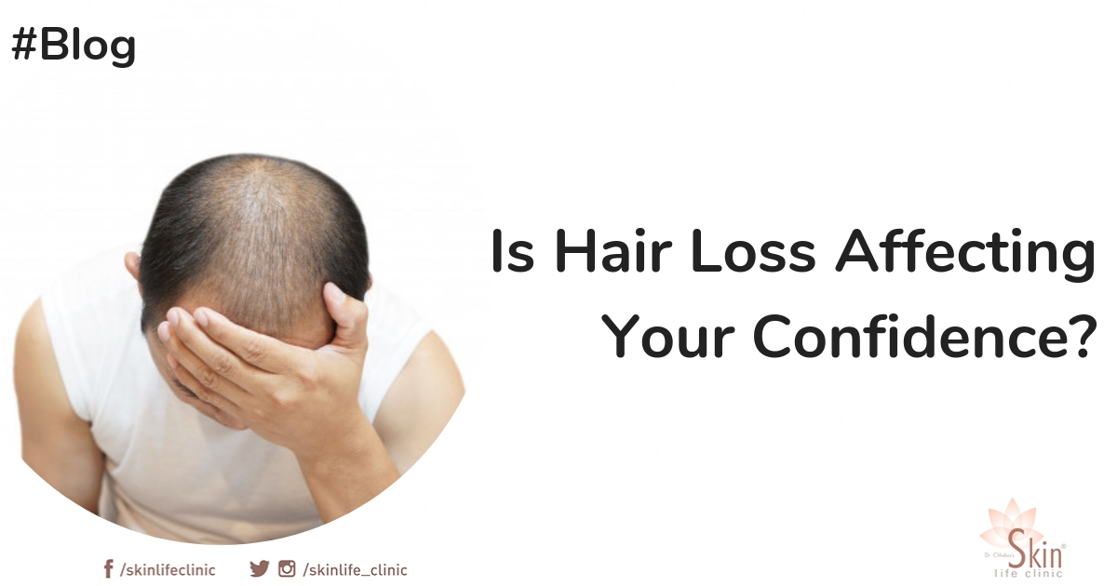
What is the problem and why does Sons exist?
The issue
80%
11%
70%
Male pattern hair loss is something that nearly 80% of men will experience¹ to some degree in their lifetime
Only 11% of men visit a clinic or professional when they start experiencing hair loss²
70%³ of men say hair loss impacts their self confidence
Notes: (1) Source: Grand View Research Alopecia Market 2025-2030, (2) Lloyds Pharamcy survey, (3) Source: Current medical research and opinion vol. 21,11 (2005): 1829-36
Notes:
Large market, growing both from a treatment and a transplant perspective. 80% of men experience some sort of hair loss , and only 11% of men while 70% say it affects their self confidence. However around 70% of customers do have not taken treatments before so how do we reach them and what do we offer them?

Slide 4
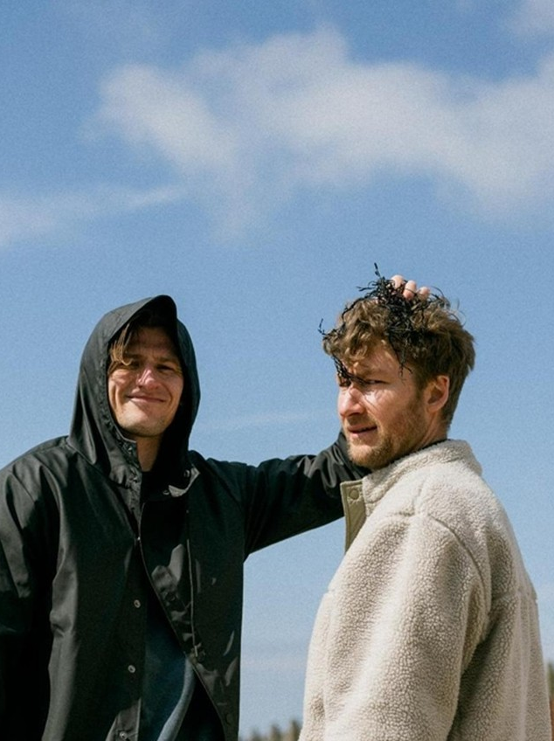

So we created a modern lifestyle brand that is grounded in an authentic story to help remove the stigma of hair loss
Sons’ brand purpose was created by understanding what men facing hair loss need and identifying what is special about Sons’ proposition, underpinned by the tagline “Show Hair Loss Who’s Boss”
What do men facing hair loss need?
What is special about Sons?
Building a brand with purpose…
Health information that men can trust
The only brand in this space that is 100% focused on hair
Back guys to tackle hair loss and get on with life!
Safe and effective solutions to men’s health needs
Sons does things properly – first line medically endorsed and licensed treatments
Relatable and honest role models
Born from Will & Adrian tackling a real first-hand problem – this spirit still defines everything Sons does
Notes:
Sons backs men to choose self confidence starting with hair, how do we equpt them

Slide 5



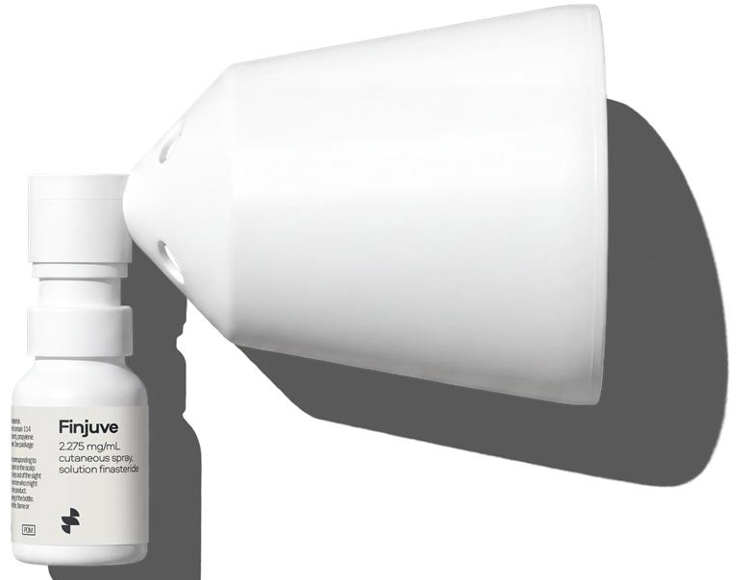
At Sons we offer our customers clinically proven medical treatments alongside more lifestyle supplements and cosmetics
Focused, clinically-proven and proprietary product offering, providing our customers a holistic treatment plan to meet their needs
Hair loss & Scalp Health
(core medical product)
Licensed POM
Licensed OTC
Sons leads with clinically proven licensed medical treatments to address hair loss and scalp concerns for their patients
D2C
Retail
D2C
Retail
Marketplaces
Oral POMs
Minoxidil 5%
Ketoconazole
POMs are available via an online consultation on D2C
Finjuve
Hair loss & Scalp Health
(supplementary hair health product)
Cosmetics
Supplements
Devices
Complementary range of medical and non-medical products to increase product bundling opportunity; driving AOV, brand engagement and lifetime value
Shampoos & Conditioners
Hair Growth Complex
Derma Roller
Clay
Biotin
D2C
Retail
Marketplaces

Slide 6


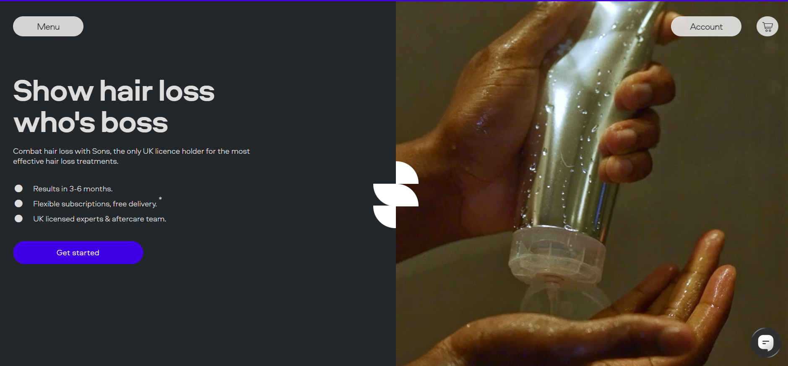
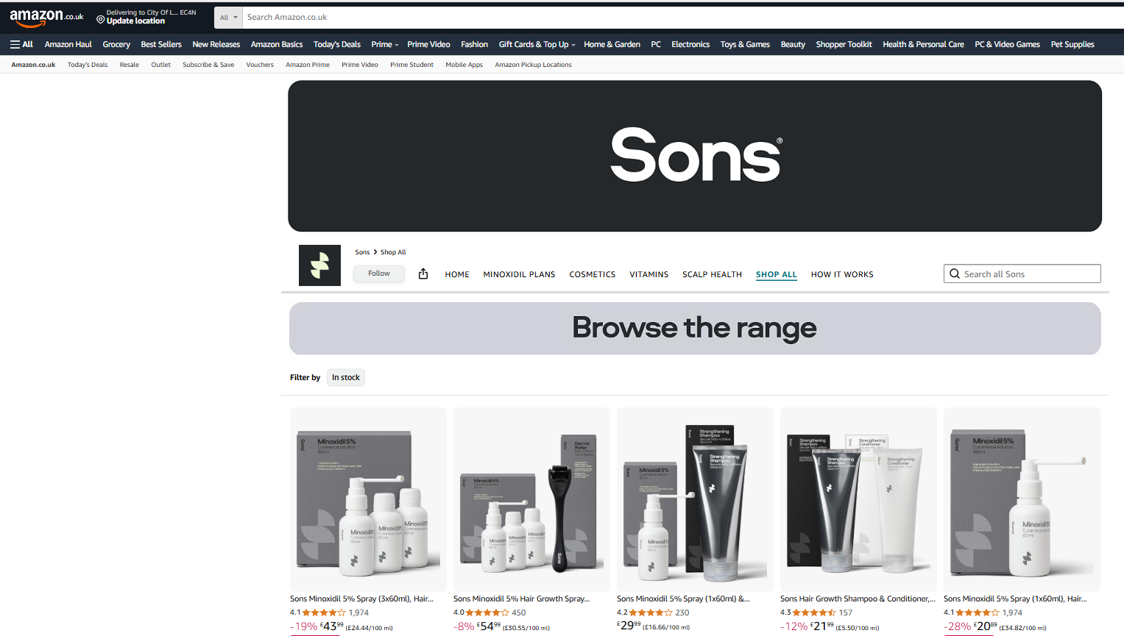
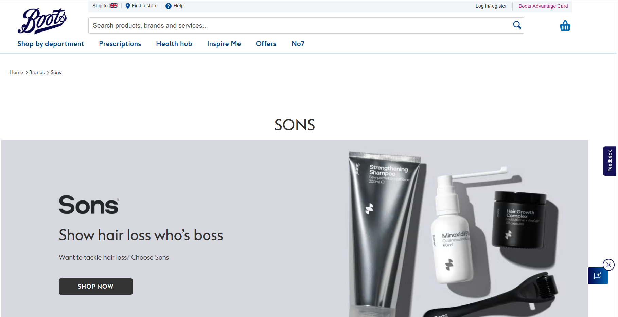
Sons combines this modern brand with medical treatments in a multichannel model that replicable and scalable
Sons’ channel strategy is reflective of its desire to meet its customers wherever they are on their hair loss journey by being accessible in the places that they shop, driving brand awareness and lifetime value
Launched
Pipeline
Launched
Pipeline
Launched
Pipeline
Launched
Pipeline
D2C
Sons’ main channel, offering customers an end-to-end brand experience from consultation to aftercare.
Amazon / Marketplaces
Core discovery channel for customers experiencing mild hair loss or hair quality issues, representing a significant portion of the market.
Retail
Includes retail pharmacies (online / offline) and online doctors. The retail channel is a trust and visibility amplifier, which broadens customer touchpoints, deepens brand recognition
HCP referral
HCP referrals from clinics and key opinion leaders creates a halo effect of trust around the brand, strengthening medical authority and credibility,
Severe / moderate hair loss & scalp health
Mild hair loss & scalp health
Mild hair loss & scalp health
Severe / moderate hair loss & scalp health
Targeting
c.15%
of D2C traffic to be driven from this channel
68%
12m retention rate for customers referred from clinics vs. c.50% across overall D2C
Product access:
Prescription product
Licensed OTC product
Product access:
Licensed OTC product
Cosmetics / supplements
Product access:
Licensed OTC product
Cosmetics / supplements
Product access:
Referral to the D2C channel
Focus on Finjuve (patented asset) to drive referrals

Slide 7






Operating in a fragmented market where Sons is the only brand with an omni channel and subscription D2C approach
Men’s Hair Loss Treatments market (2025)¹
D2C brands
Amazon
Retail
Clinics
Global Market Size
£4.1bn
£80m
market size⁴
20% market CAGR
£100m
market size
3% market CAGR
£900m
market size⁵
1% market CAGR
£200m
market size⁶
20% market CAGR
Market (EU)³
European Market
£1.3bn
Medicine-led product offering providing clinically proven treatment solutions that can be accessed through online consultation
Mix of OTC and cosmetic, supplement players
Mix of OTC and cosmetic, supplement players
Traditional retail is dominated by Regaine
High value customers seeking pre- and post-operative medically endorsed treatment to enhance their overall treatment solution
UK, IE and DE Markets
£520m
Description
Players
Notes: (1) Source: Grand View Research Alopecia Market 2025-2030 with approximate regional allocation calculated using the regional split per the Grand View Research Report Alopecia Market Analysis 2020, (2) Calculated using gross revenue as a percentage of the UK, IE and DE markets, (3) Source: Grand View Research, Hair Loss Telehealth Market and management estimates, (4) Management estimate based on combination of Sons, Voy, Hims, Scandinavian Biolabs and MySpring hair loss turnover, (5) Includes physical/online retail and physical/online pharmacy, (6) Extrapolated based on Sons’ percentage customer acquisitions, (7) In UK and IE: Sons, Regaine and Axunio Pharma (Manual product although not currently present on their platform) and in Germany: Sons, Regaine, DoppelherzPharma, Minocutan and Alocutan, Manual have an inconsistent presence but do sometimes have 5% Minoxidil available via a distribution agreement where Axunio Pharma are the license holder

Slide 8
Sons operates a full-funnel acquisition model combining organic, partnership and performance channels which benefit all channels
Marketing funnel
Overview
Top of funnel
TV/Radio Advertising & Podcasts
Reaching high-value customers where they already spend time: TV, podcasts, digital video – to build awareness across all Sons channels
Sons’ full-funnel acquisition model drives a large share of organic traffic that has been growing relative to paid channels (organic traffic now representing c.60% of all traffic) - limited reliance on Meta / paid channels compared to other competitors in the D2C space
Influencers/Partnerships
Sons’ sports-driven approach is strengthened by grassroots partnerships that bring local authenticity and community reach
Marketing spend by channel (FY26A)
Clinics/KOLs
Clinics represent one of Sons' highest-quality acquisition channels (currently 12.5–15% of new D2C customers), with significant headroom
Performance marketing
Focused on high-intent demand capture (Google) alongside under-penetrated scalable channels (e.g. Meta, YouTube). Localised content is driven into Sons’ digital demand engine, ensuring hyper-relevant ads at county level
Bottom of funnel
Sons holistic marketing strategy and channel approach enables efficient customer acquisition, retaining customers because the treatment works, with profits then reinvested to accelerate growth across predictable channels and markets

Slide 9
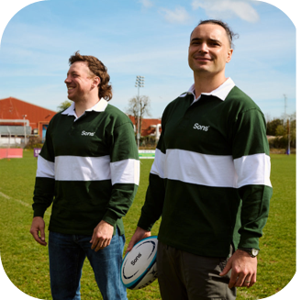




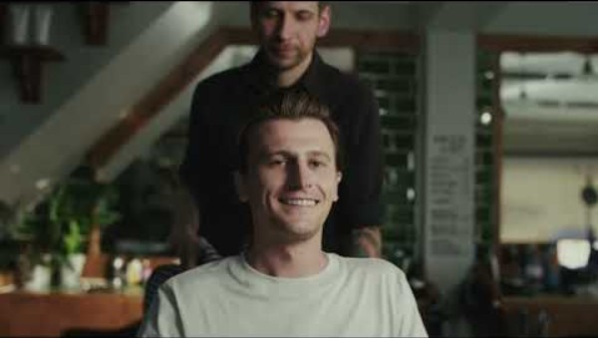
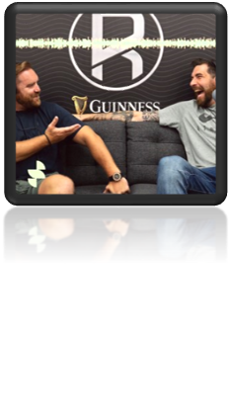

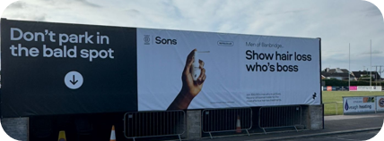
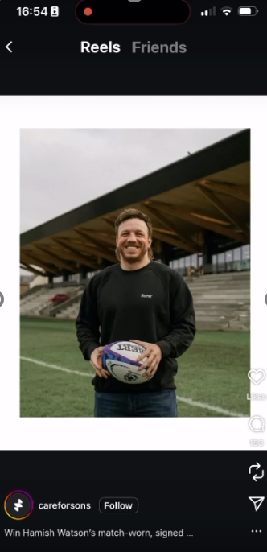
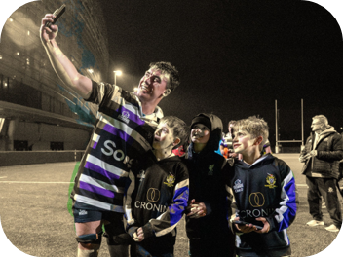




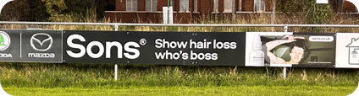
We leverage customer personas that resonate and content that can benefit across channels and segments
No1
Strategy to become front of mind for hair - targeting High Value Personas ‘Where they hang out’ and reaching them from top to bottom of funnel.
Above the line
Run TV ads across key competitions, alongside podcasts such as Heineken Cup, Gallagher prem, Autumn Internationals, Rugbypod
Influencers
Working with hero ambassadors in the sport
Example: Rugby fan persona
v
v
Grassroots
Sponsorships
Sponsor club teams across UK and Ireland
Performance Marketing
Targeting rugby interests on Google, Youtube, Meta, TikTok
We execute a similar strategy against other persona types
Source: Google Analytics, SEOMoz , FB, Sky, SpiderPR

Slide 11
Summary and Thank you
What have we done?
What does it mean?
A modern brand with an innovative model and with a digital first approach
Speaks to consumer’s directly and offers solutions alongside education that they want
Clinically proven treatments based on evidence combining medical and non-medical treatments
Leading with science leads to efficacy which drives customer retention
Multichannel business (e-comm, subscription, marketplaces, pharmacy)
Meets the customer where they are and act’s a flywheel in terms of business growth and brand awareness
Scalable platform that can we replicated and is ready for Geo expansion
Set up to move fast and enter new markets when required

