Slide 1


Wellness Investing Landscape
Market context, capital flows, and our approach to venture investing
Five Seasons Ventures • Valerie Evans, Principal • September 2026

Slide 2
Today's Discussion
1
Agenda
01
Who we are
About FSV
02
Industry overview
Why wellness is a durable, investable category
03
M&A activity
Across multiple verticals
04
Our investment lens
How we evaluate companies & how we help companies scale
05
Whitespace & opportunities
Where we're hunting next
Wellness Investing Landscape

Slide 3

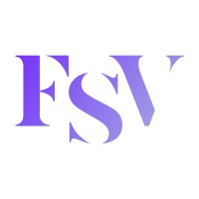


1. Who we are
2
Who are we: a dedicated Consumer Fund focused on F&B >€430m, 27 investments, 4 exits and €1.3bn of value created, in just 8 years
Final closing at €196m
Exit
2025 - 2026
2022
Exit
Fund III
2018 - 2021
10 investments across UK, DE, IT, & FR
We bring more than just capital
In-depth knowledge of challenger consumer brands growth strategies
Active role in attracting talent, capital, and crafting successful exits
Strong network with strategics
2023
Exit
2018
Fund I: €77m
2021
Fund II: €180M
Wellness Investing Landscape

Slide 4
2. Industry Overview
3
Consumer health and wellness keeps compounding globally, with Europe continuing to see solid growth in the sector
Global Consumer Health Market Size (€bn, fixed FX rates)
Growth Rates by Region (% CAGR)
2014–19
2019–21
(Covid)
2021–23
(Inflation)
2023–25
Eastern Europe
6.1%
5.0%
8.4%
7.9%
Western Europe
3.9%
2.3%
8.4%
5.6%
North America
4.2%
5.7%
4.8%
3.6%
Asia Pacific
6.6%
4.3%
8.1%
3.3%
Global
5.3%
4.8%
7.3%
4.9%
Source: O&C analysis; Euromonitor.
Wellness Investing Landscape

Slide 5
2. Industry Overview
4
European per capita wellness spend still has significant headroom
Annual VMS Spend per Capita, 2015 vs. 2025 (€)
~3x
UK had the highest per capita growth rate during this period (136%)
US per-capita VMS spend is roughly 3x Western Europe's today. We expect this gap to shrink over time
Eastern Europe
€12 → €30
+147%
Western Europe
€24 → €41
+68%
USA
€92 → €131
+43%
Source: OC&C analysis
Wellness Investing Landscape

Slide 6
2. Industry Overview
5
Our conviction in wellness is underpinned by durable demand tailwinds
1
2
3
Demographics & Behavior
Willingness to Pay
Scientific Credibility
Aging populations, rising chronic disease, and a lack of existing healthcare structures focused on preventive measures are creating a shift toward self-care + prevention over cure
Consumers protect wellness spend even in downturns. Propensity to pay has increased, even without requiring a medical necessity to prompt a purchase
An accelerating base of published research and clinical substantiation is legitimizing consumer claims and increasing ingredient assortment
4
5
6
Channel Evolution
Format Innovation
Broadening Need States
Online sales channels (DTC, Amazon, and TikTok) have lowered the barrier to entry for new brands with the ability to reach consumers effectively and create recurring revenue more easily
Demand for enjoyable, easy-to-take formats (gummies, powders, patches) is expanding the addressable market
Traditional need states among immunity & daily nutrients still exist, but more research, funding, and time is spent on burgeoning categories in women’s health, longevity, sleep, hormones
Source: Global Wellness Institute.
Wellness Investing Landscape

Slide 7
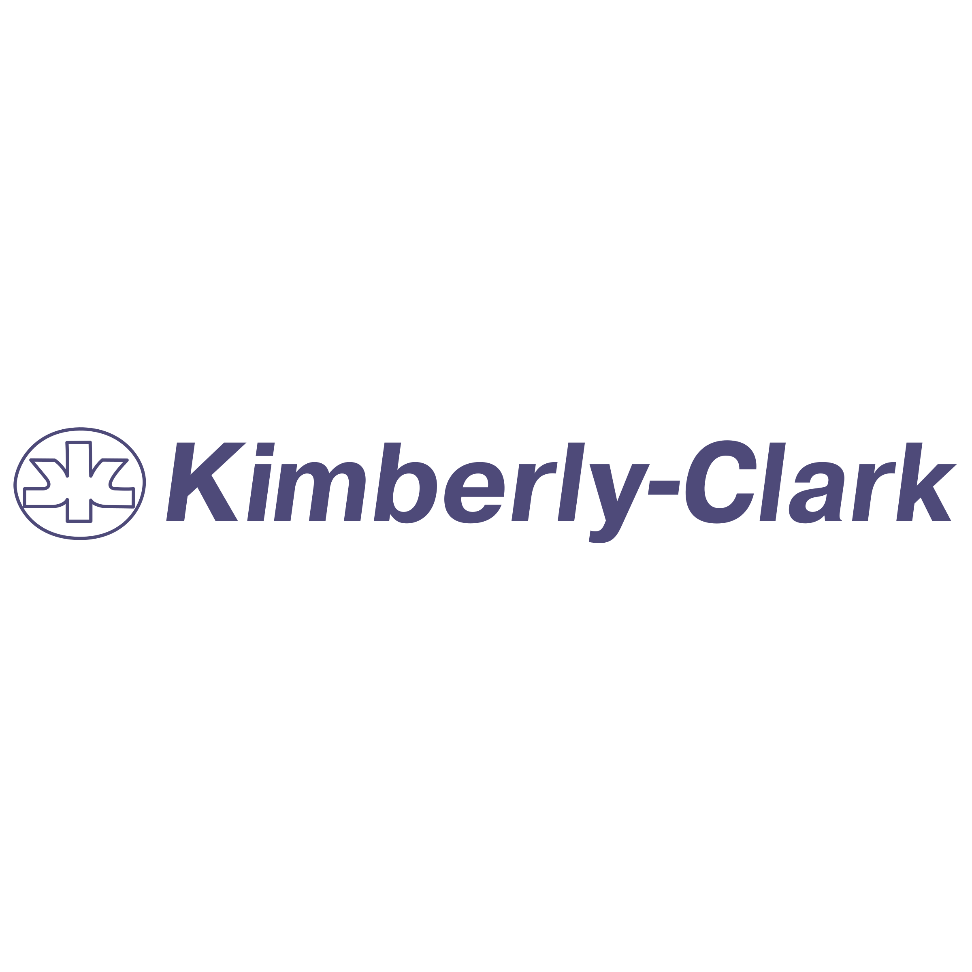




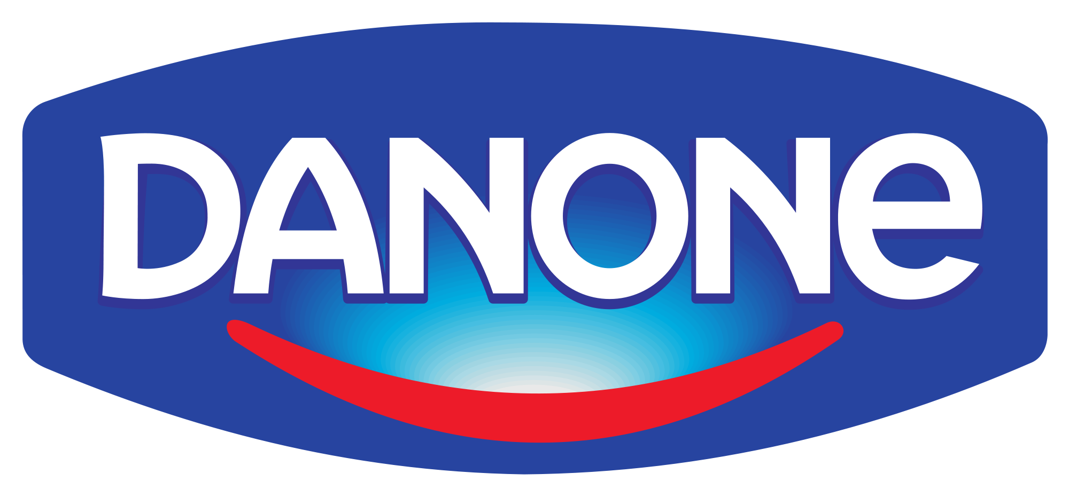




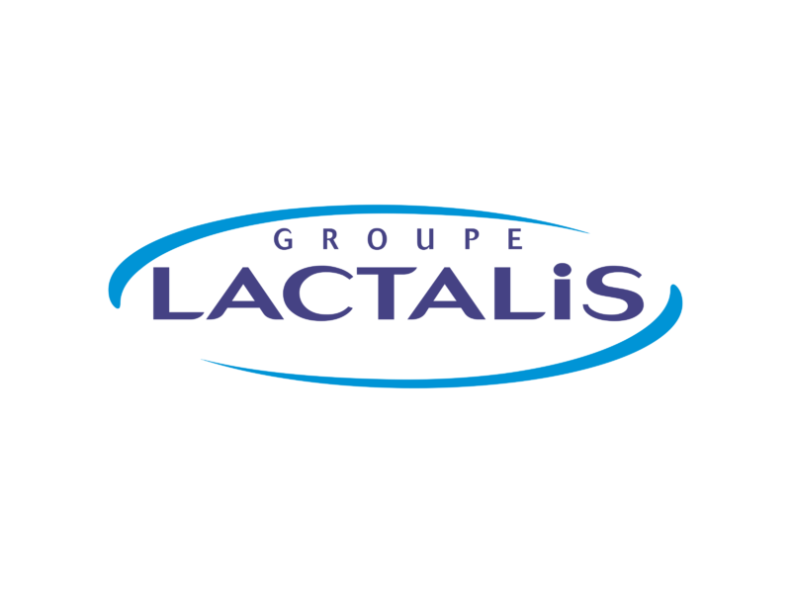











3. M&A Activity
6
M&A is being driven by a broad range of stakeholders, not just strategic acquirers
Consumer Health Majors
Broader CPG MNCs
Platform Consolidators
Private Equity / Investors
Representative deals, last 24 months: Kimberly-Clark / Kenvue · Unilever / grüns · Danone / Huel · CVC (Cooper) / Opella · KKR / karo · Capvest / STADA
Sources: OC&C analysis; Capital IQ
Wellness Investing Landscape

Slide 8
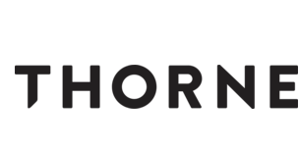


3. M&A Activity
7
Acquisitions are being made across the wellness spectrum
← OTC PLAY
LIFESTYLE WELLNESS →
$1.2B
$3.8B
$1.2B
Pure-Play OTC
Practitioner-Led, DTC Platform
Format Innovator
Offline penetration through pharmacies creates market depth
Formulations grounded in scientific research & traceable quality
New format drives higher adherence & DTC retention
Science-led platform that relied on building trust with big names
Built through the practitioner network; online expansion now driving growth
Leaned into consumer trends (e.g. fiber) over scientific formulation
Mix of reactive + proactive products across the family spectrum
Positioned around preventative wellness for multiple need states
Deal rationale centered on acquiring the consumer base
Wellness Investing Landscape

Slide 9

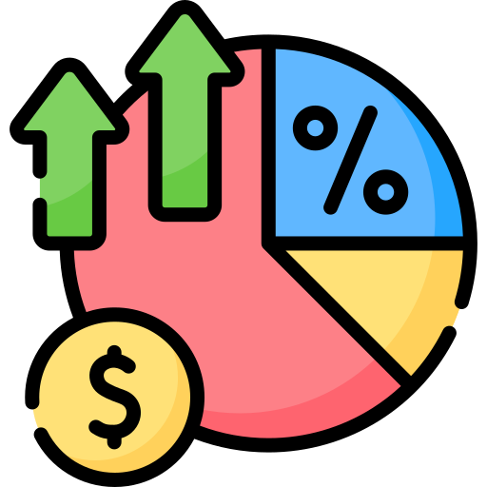



4. Our Investment Lens
8
What makes a good investment for us:
We invest in companies striving to build repetitive and loyal consumer habits
High Average Order Value
Mass premium positioning
High margins
60%+ average across our portfolio
High
Retention
Category-specific benchmarks across 1000s of companies screened
FSV pattern recognition and benchmarks
High growth
>50% y-o-y, most companies profitable
> €10m revenues
Sustainability champions
Screening tools and Incrementality plan
Wellness Investing Landscape

Slide 10
4. Our Investment Lens
9
We evaluate every wellness investment against six pillars, bolstered by brand momentum
Right to Win
Not every product in the wellness space needs to be the most scientific innovation – the product either needs to sit firmly within a formulation, format, or lifestyle moat. Efficacy substantiation and claims credibility are required.
Growth Quality
Revenue growth by product & channel; is growth broad-based or concentrated in one SKU or platform? How quickly does a customer payback their acquisition cost on a margin basis?
Unit Economics & Retention
Cohort retention curves, LTV:CAC, and margin stack (CM1/CM2/CM3 → EBITDA) trending in the right direction
TAM & Ambition
Realistic path to category leadership; whitespace runway beyond the current core offering or expansion into other demographics with the core offering
Scalability & Team
Operational infrastructure, supply chain resilience, and a team capable of executing the next stage
Impact & Credibility
Sourcing, sustainability, and claims governance — increasingly a diligence and brand-trust issue, not a checkbox
Brand momentum is not defined by one single metric – it can be channel traction, social media resonance with its target consumer base, or strong recurring revenue, indicating that there’s a strong subscription base underpinning growth
Wellness Investing Landscape

Slide 11
4. Our Investment Lens
10
We actively support portfolio companies to drive a maintain value
Growth
Playbook
Equity
Story
Governance
Operational Assistance
Focus drives results
Insights and access
Alignment of interest
Channel
From DTC to omnichannel
Network
Strategics/Bankers/
Private Equity
Capabilities
Claims substantiation & supply chain update
Product
Quality and new product development
FSV Capital
Follow on capital available
Benchmarking
Operational best-in-class insights
Geography
In depth knowledge of multiple markets
Further Funding
€500m equity /
€40m debt raised
Talent
7 Management Roles, 3 NXD, 3 Experts
Wellness Investing Landscape
Notes:
7 Management Roles, 3 NXD, 3 Experts
Have assisted portfolio companies in raising 500m equity / 40m debt

Slide 12
5. Whitespace & Opportunities
11
Six white-space areas are shaping where we focus new sourcing efforts
1
2
3
Longevity & Health-Span
Metabolic Health
Women's Health
Preventive, biomarker-driven products moving from niche to mainstream demand
GLP-1-adjacent nutrition, muscle preservation, and complementary care models
Historically underserved need states (chronic conditions, menopause) with no current product available or low current product satisfaction
4
5
6
Format & Delivery Innovation
Focus / Energy
Broader Hormone Health
Enjoyable, easy-to-take formats capturing share as efficacy alone is no longer sufficient
Cognitive performance and stress-resilience products moving from niche biohacking into mainstream routines
Testing and treatment for thyroid, cortisol, and other hormone imbalances are moving into everyday consumer wellness
Common thread: categories where an underserved consumer need and a clear route to market intersect — our check size sweet spot is between €2–10M.
Wellness Investing Landscape

Slide 13
5. Whitespace & Opportunities
12
Our house view: a structurally attractive category with real execution risk to underwrite around
Category Upsides
Category Risks
Building Blocks for Growth
1
Multi-billion euro, structurally growing category with resilient consumer spend, even in downturns
1
Generally high marketing spend required early on in brand days to successfully differentiate
1
Create a true moat in formulation, format, or habit change. Owned scientific / IP in conjunction with consumer marketing momentum is king
2
Genuine white space (women's health, longevity, metabolic) with emerging scientific credibility
2
Geographic preferences, channel differences (online vs. offline; offline variations) can slow expansion in EU
2
Channel efficiency and capital-efficient acquisition strategies can be leveraged in new channels + markets
3
True product market fit is exemplified in customer retention, which provides a strong base for capital efficient business growth
3
Fragmented, evolving claims/regulatory environment across US and EU raises diligence complexity
3
Claims-substantiation and regulatory-readiness is critical as a company continues to grow
Wellness Investing Landscape

Slide 14


Backing the next generation of wellness brands
Thank you — let's discuss where our thesis and your roadmap align.
Five Seasons Ventures
107 Rue Reaumur, Paris, France 75002
valerie@fiveseasons.vc

