Slide 1

A bit of FMCG Tricks to Influece Growth
Fernando Cobos

Slide 2
Who am I?
+22 years Turning Consumer Insights, AI & Analytics into Brand Growth
Many different Industries, from Food to Wound Care
B2B and B2C expertice
Focused on driving growth.

Slide 3
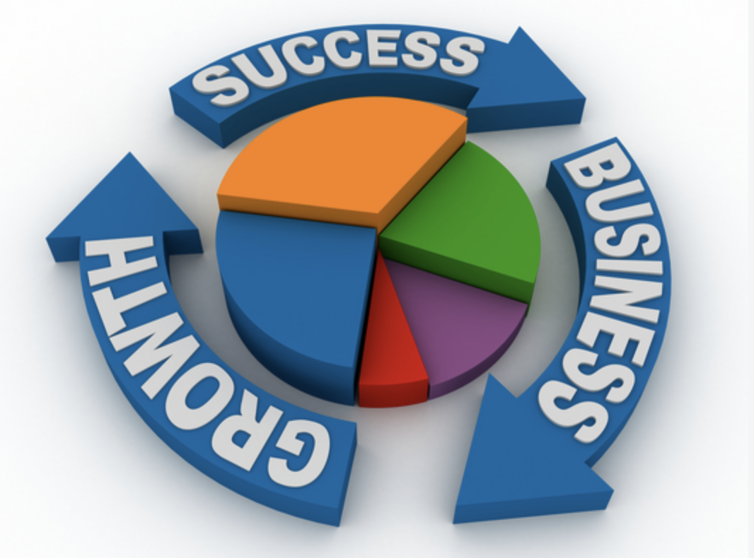
The final objective of every business is to grow
Notes:
Sell more, but how, to whom, where, at what price, etc… Gorowth amnitions, are the same in all your organization, local, global, etc…

Slide 4
Measurment is key
To bring growth is imperative to have a proper measurement, and the key metric to track is PENETRATION.
“House Hold Penetration”
“The percentage of households in a defined market that have purchased a specific product at least once within a given time period.”
Notes:
Bring the importance of this concept from the product perspective and for the brand perspective

Slide 5

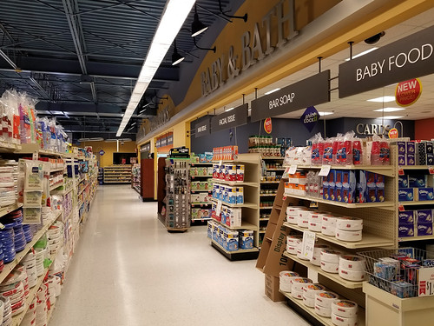
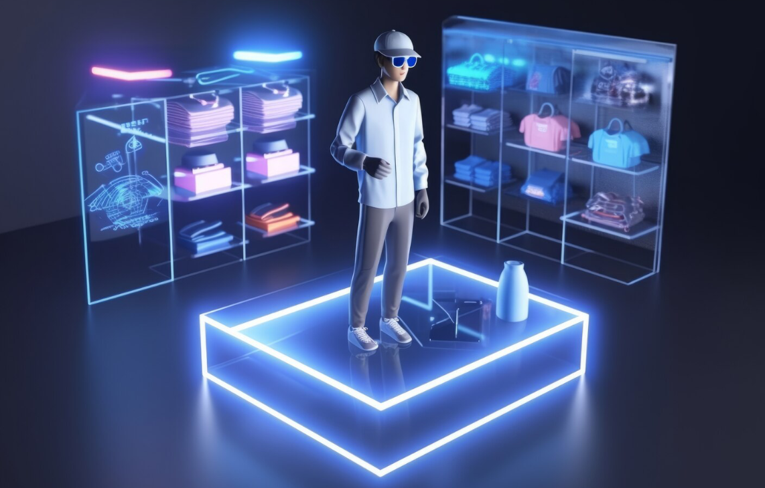
What does OTC have in comon with FMCG

Slide 6
Penetration
Physical Availability
Mental Availability
Product / Service

Slide 7
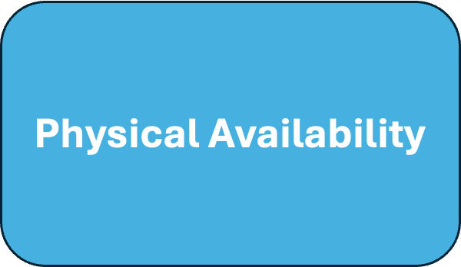
Physical Availability
Is the ease with which a buyer can find and buy a brand/product in their specific buying situation.
  Presence: Being sold in the right stores, websites, or sales channels where customers actually shop.
  Prominence: Being easy to see and notice on a shelf or a digital screen through clear branding and good placement.

Slide 8
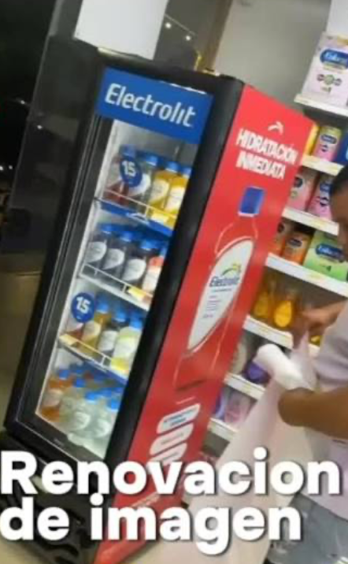
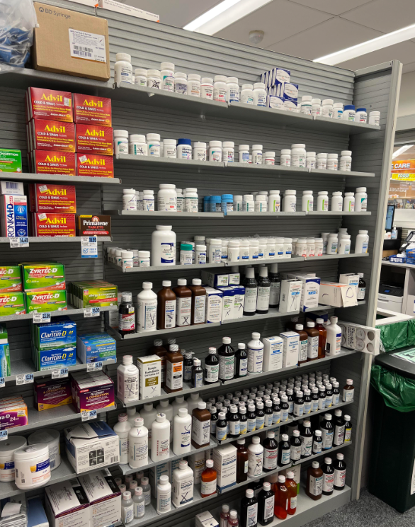
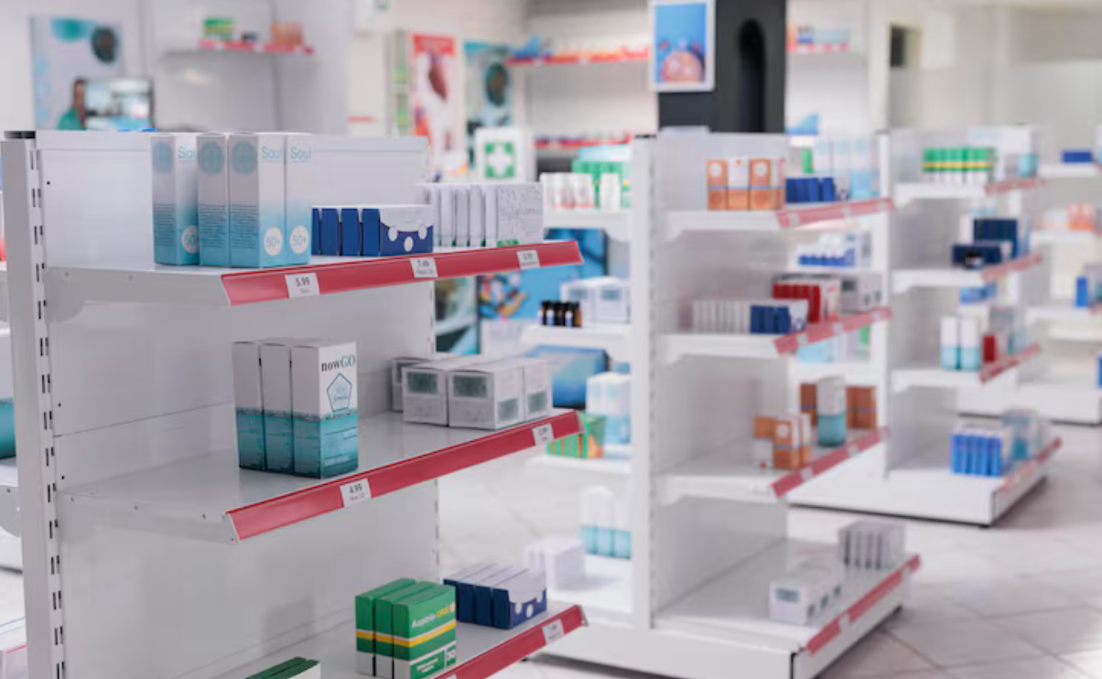
Presence and Prominence

Slide 9
Physical Availability example of KPIs
Is the ease with which a buyer can find and buy a brand/product in their specific buying situation.
Physical Availability
Distribution WD % vs Category
Distribution WD SKU Actuals
Share of Shelf Physical
Share of Shelf Digital
Channel Predence Physical
Channel Predence Digital

Slide 10

Mental Availability
Is the ease with which a buyer have in mind our Brand/Product at the specific shopping situation.
  Category Entry Points (CEPs): These are the internal cues, external environments, or consumption contexts that prompt a buyer to look into a category (e.g., "I need a quick afternoon snack," or "I want to buy a thank-you gift"). Higher mental availability means your brand is linked to a wider variety of these situational cues.
  Distinctive Brand Assets (DBAs): These are non-verbal, sensory cues (such as logos, specific colors, catchphrases, or mascots) that help consumers immediately recognize the brand without having to consciously process text.
Notes:
Mental Availability maps the complex web of memory structures. It looks at the quantity, quality, and freshness of the associations a consumer has with a brand across many different buying scenarios. A brand with high mental availability has built robust "hooks" in the consumer's mind, making it easy to retrieve exactly when a specific need arises

Slide 11



CEPs = Category Entry Points
https://www.instagram.com/reel/DTb0DwElNpL/?utm_source=ig_web_button_share_sheet

Slide 12
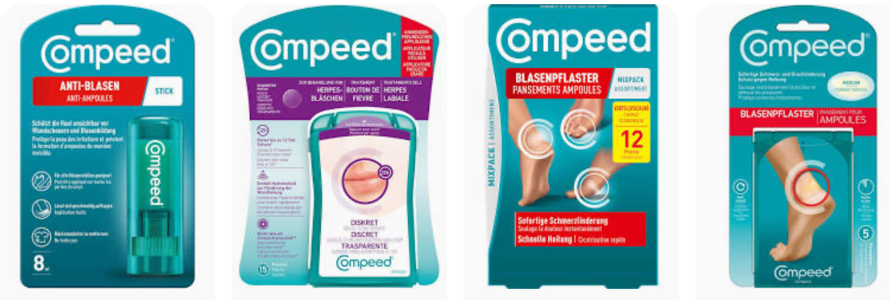
DBAs = Distinctive Brands Assets
https://www.instagram.com/reel/DTb0DwElNpL/?utm_source=ig_web_button_share_sheet

Slide 13
Mental Availability example of KPIs
Is the ease with which a buyer have in mind our Brand/Product at the specific shopping situation.
Mental Availability
Top of Mind
Aided Awareness
Media Spend
Comms Quality / Link Score
Total Reach & Total Reach +1
Total Working A&P
Working Media & of A&P
Weeks on Air
Share of Voice
Share of Search
TBCA
Notes:
Mental Availability maps the complex web of memory structures. It looks at the quantity, quality, and freshness of the associations a consumer has with a brand across many different buying scenarios. A brand with high mental availability has built robust "hooks" in the consumer's mind, making it easy to retrieve exactly when a specific need arises

Slide 14
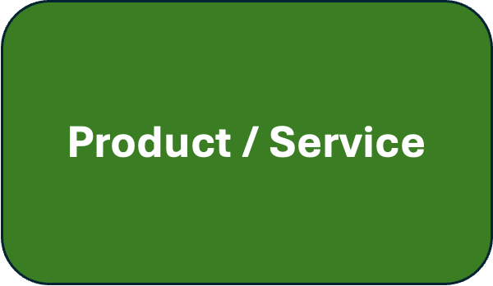
Product / Service
Is to have the right Product and/or Service offer to cover the consumer needs.
  Portfolio: Offering the right product sizes, packaging types, and price tiers for different customer needs and selling the right MIX.
  Innovation: To bring the proper ammount of new news within the category context.
  Superiority: Being percived with enough better quality against your competitors to encourage a purchase at the given price.

Slide 15
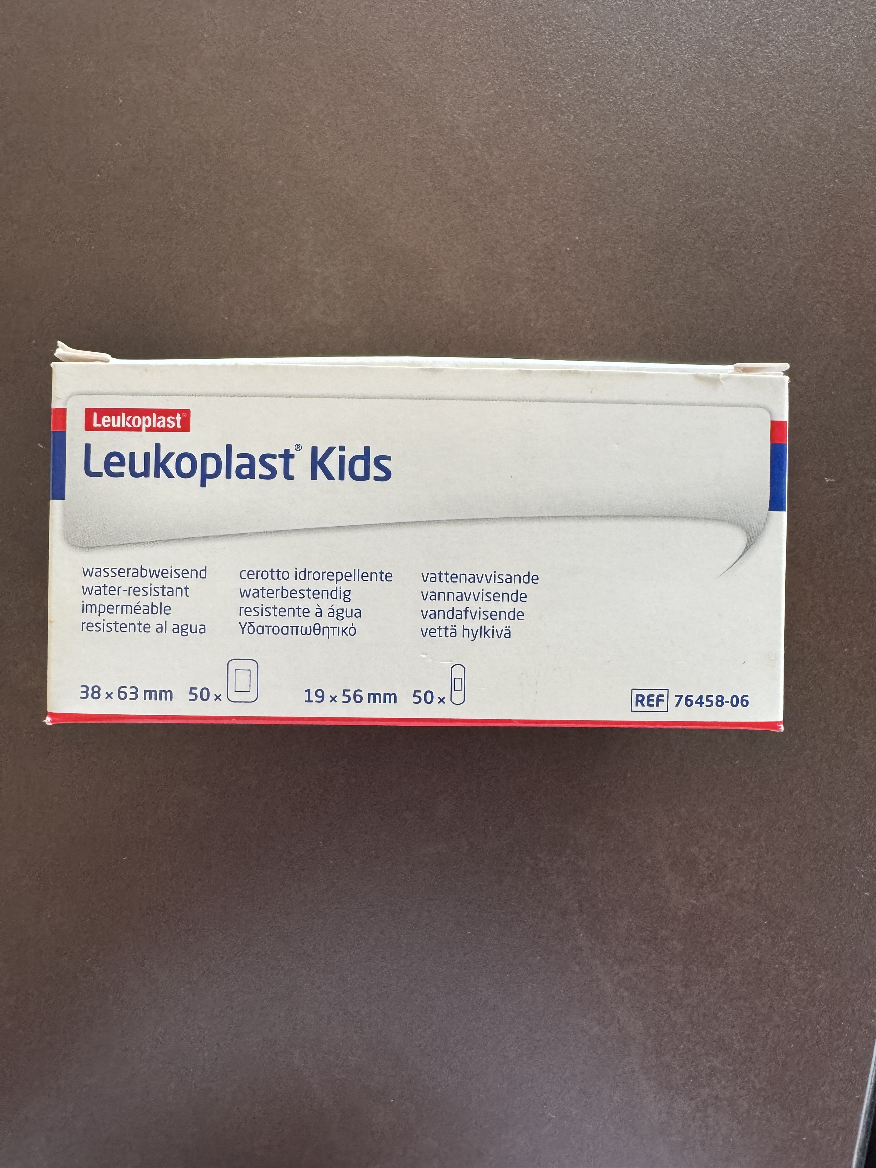
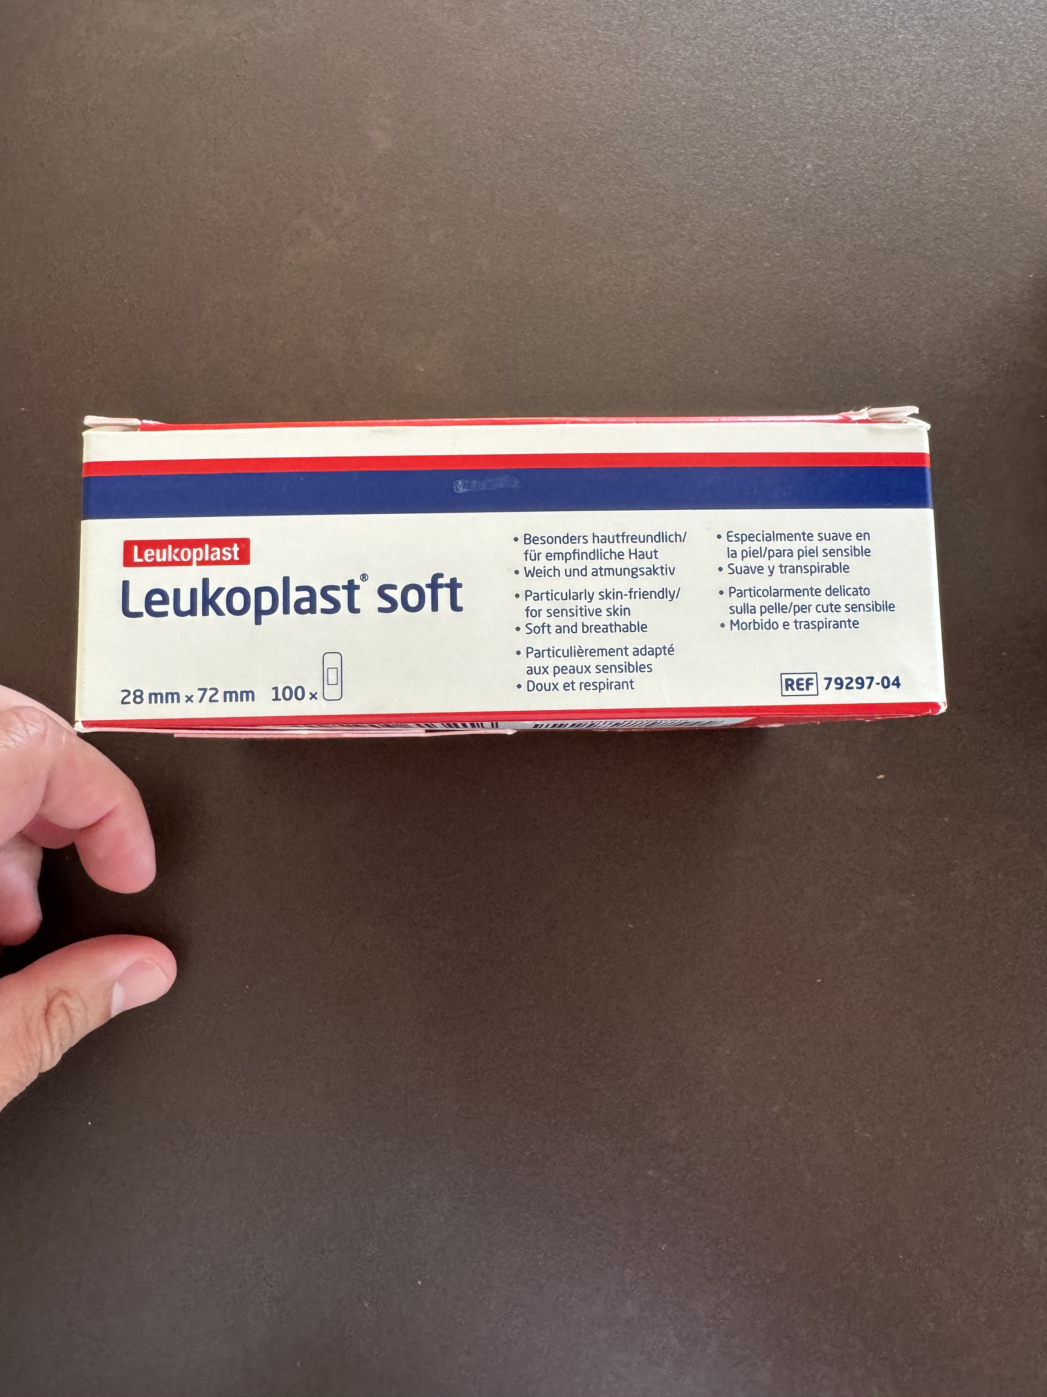
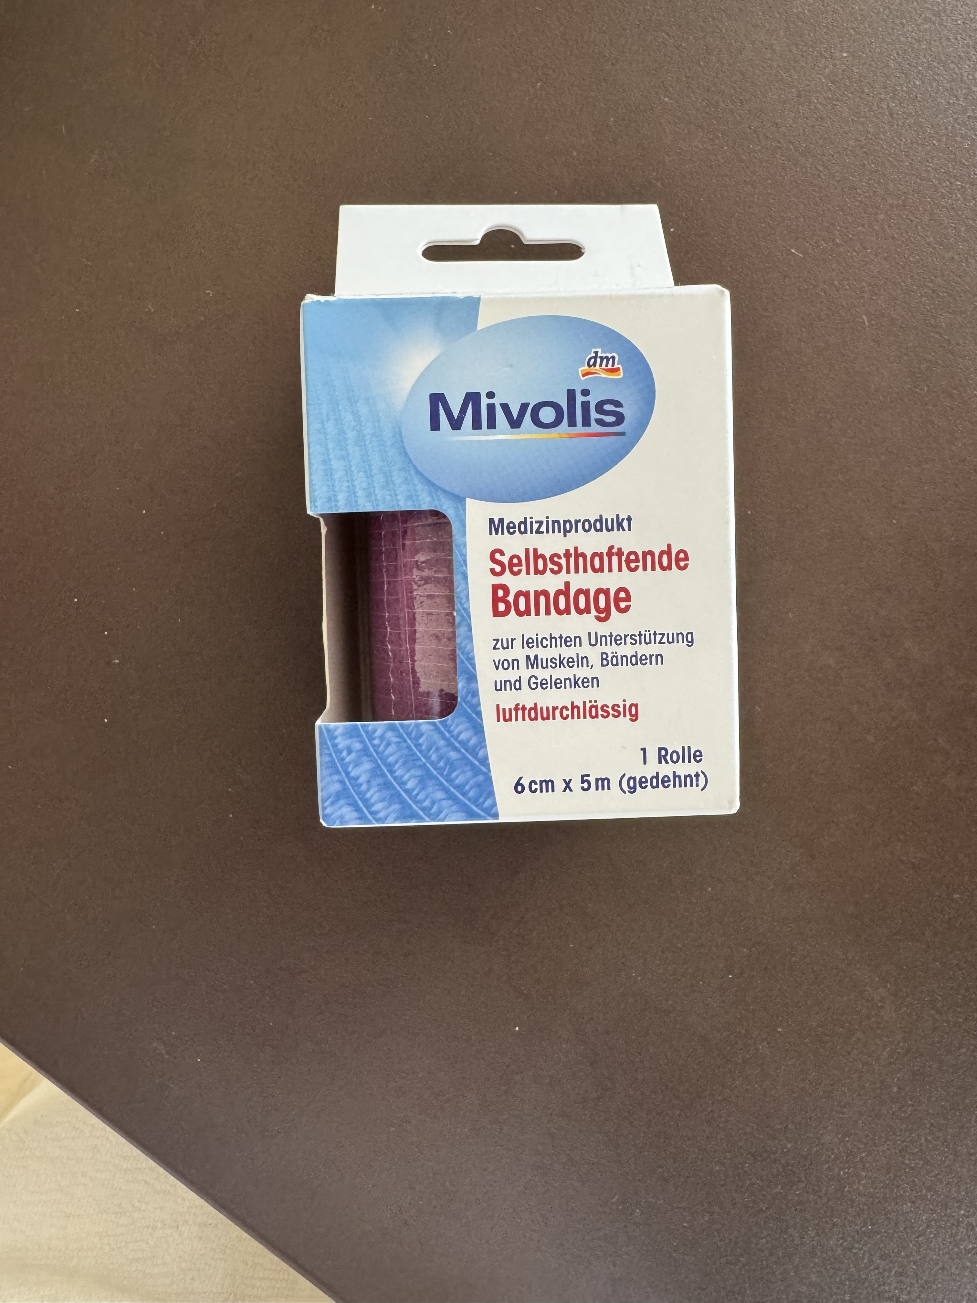
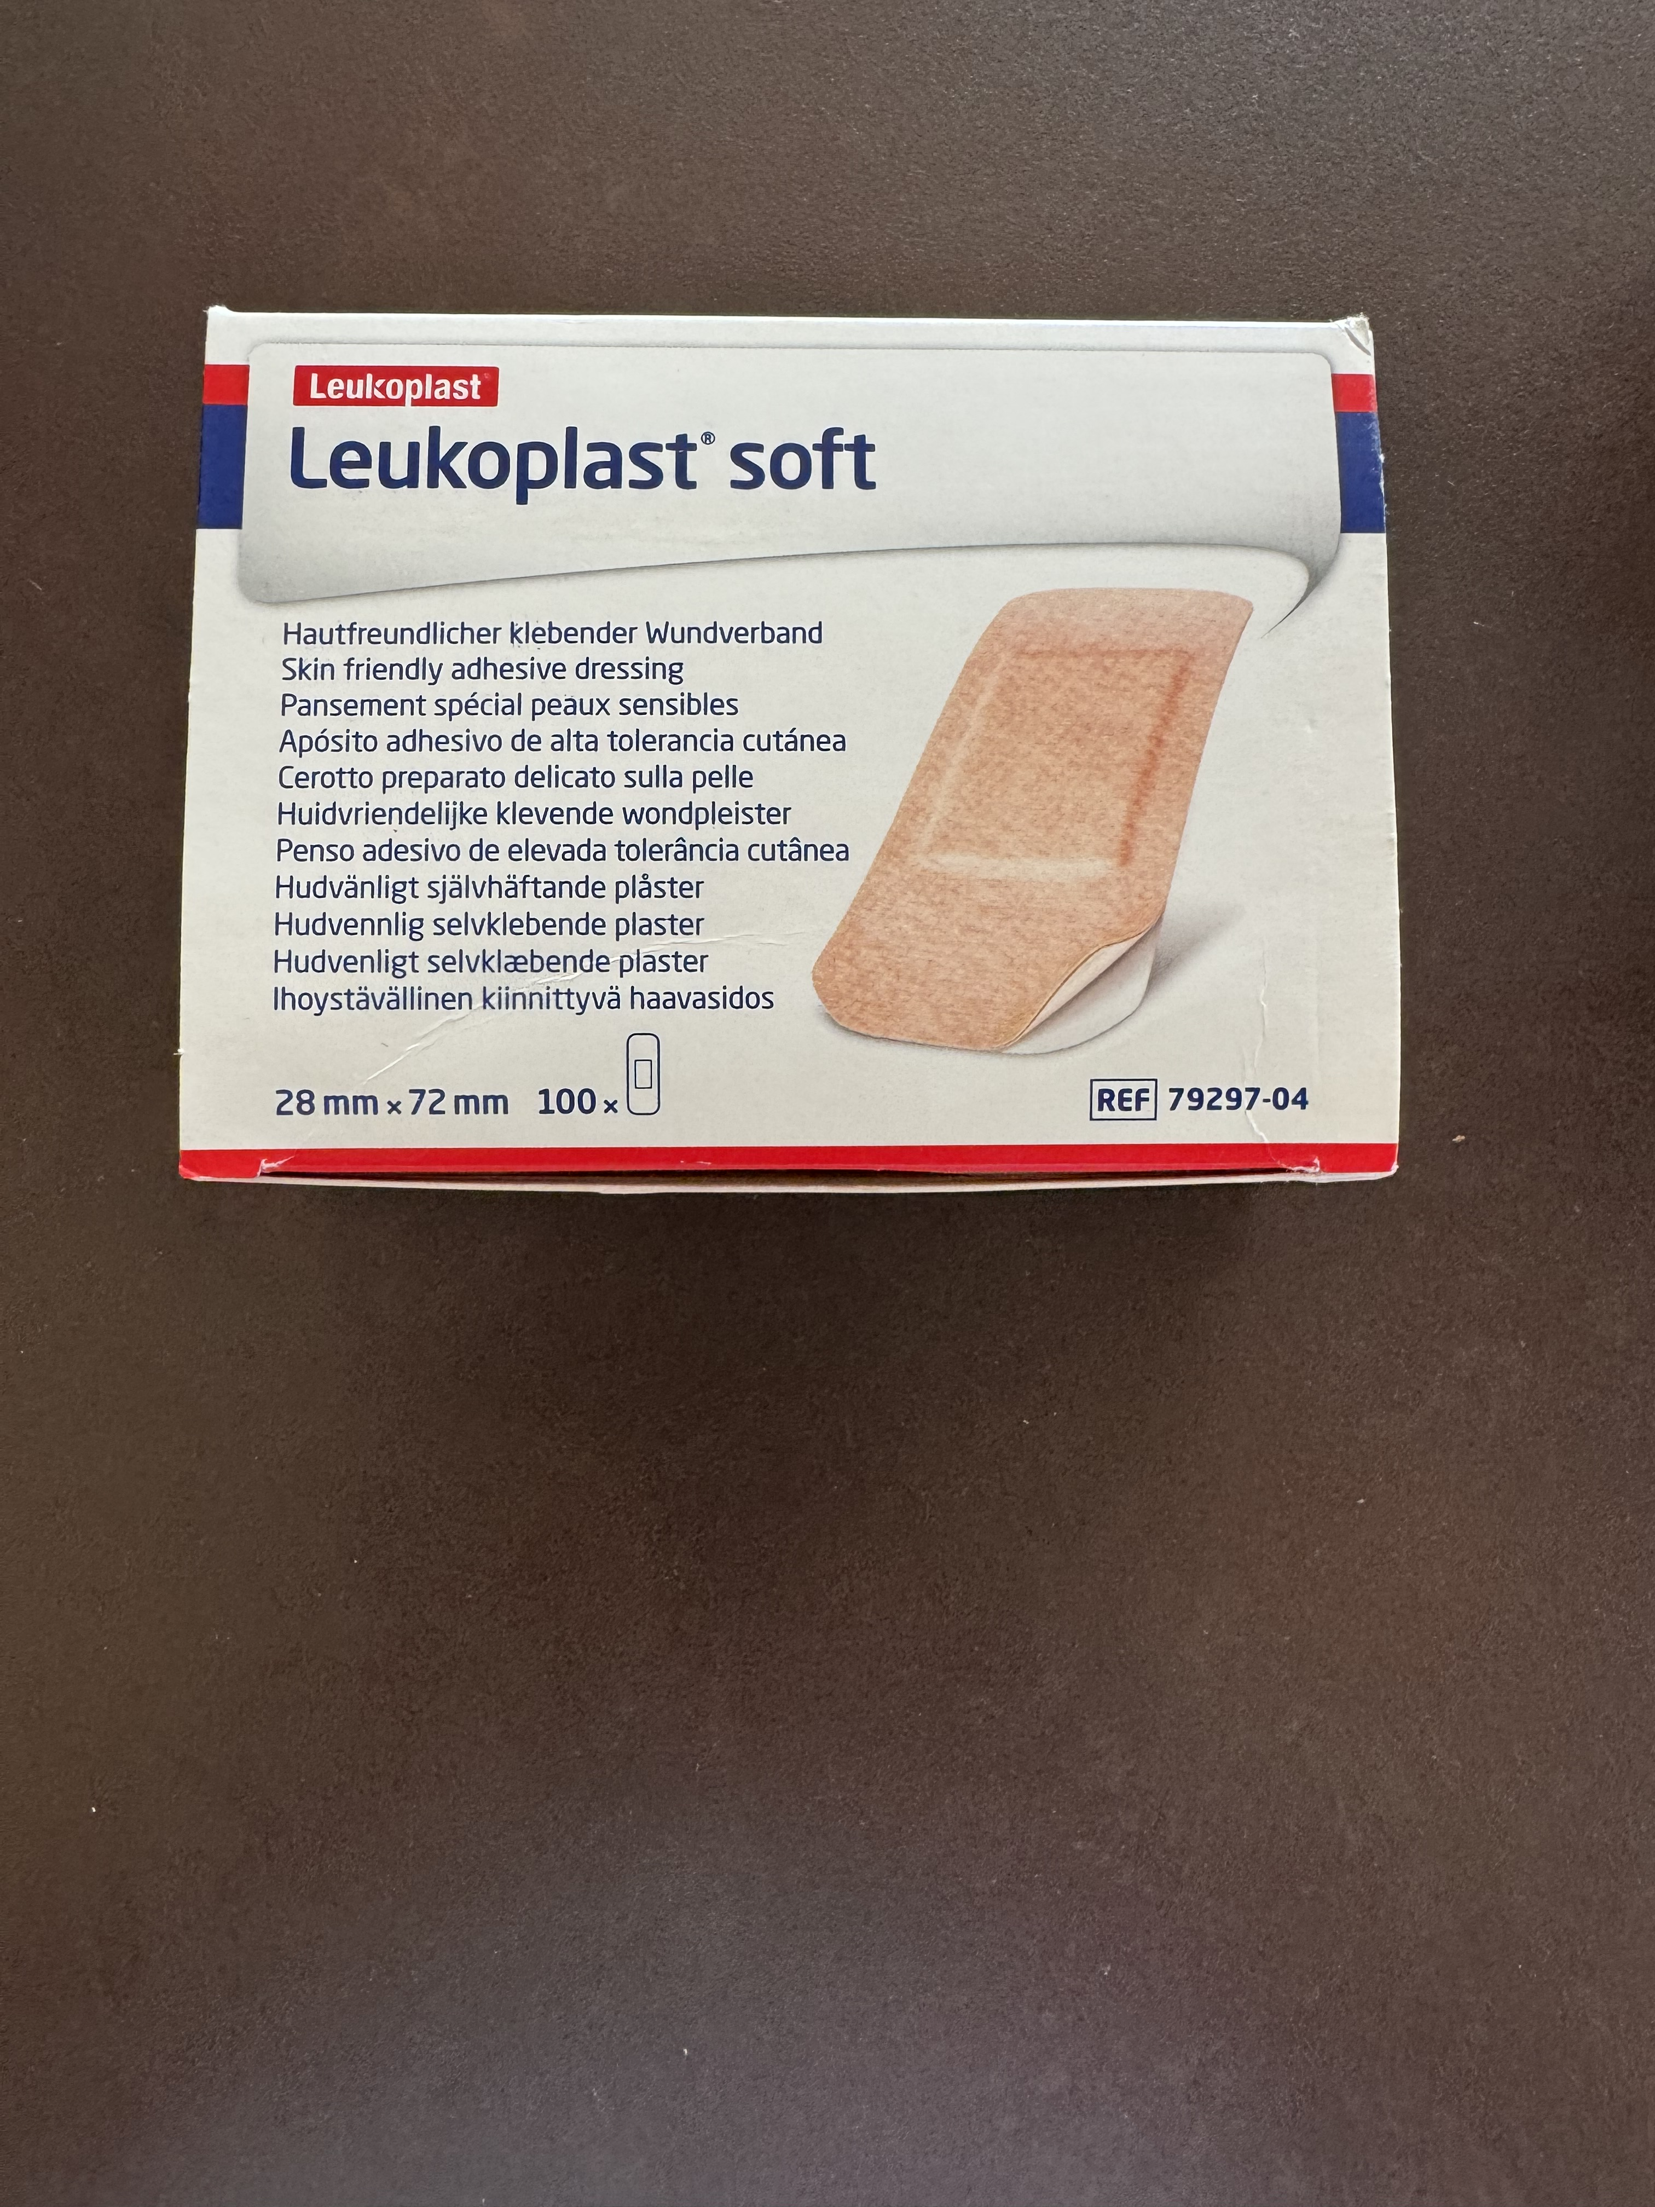
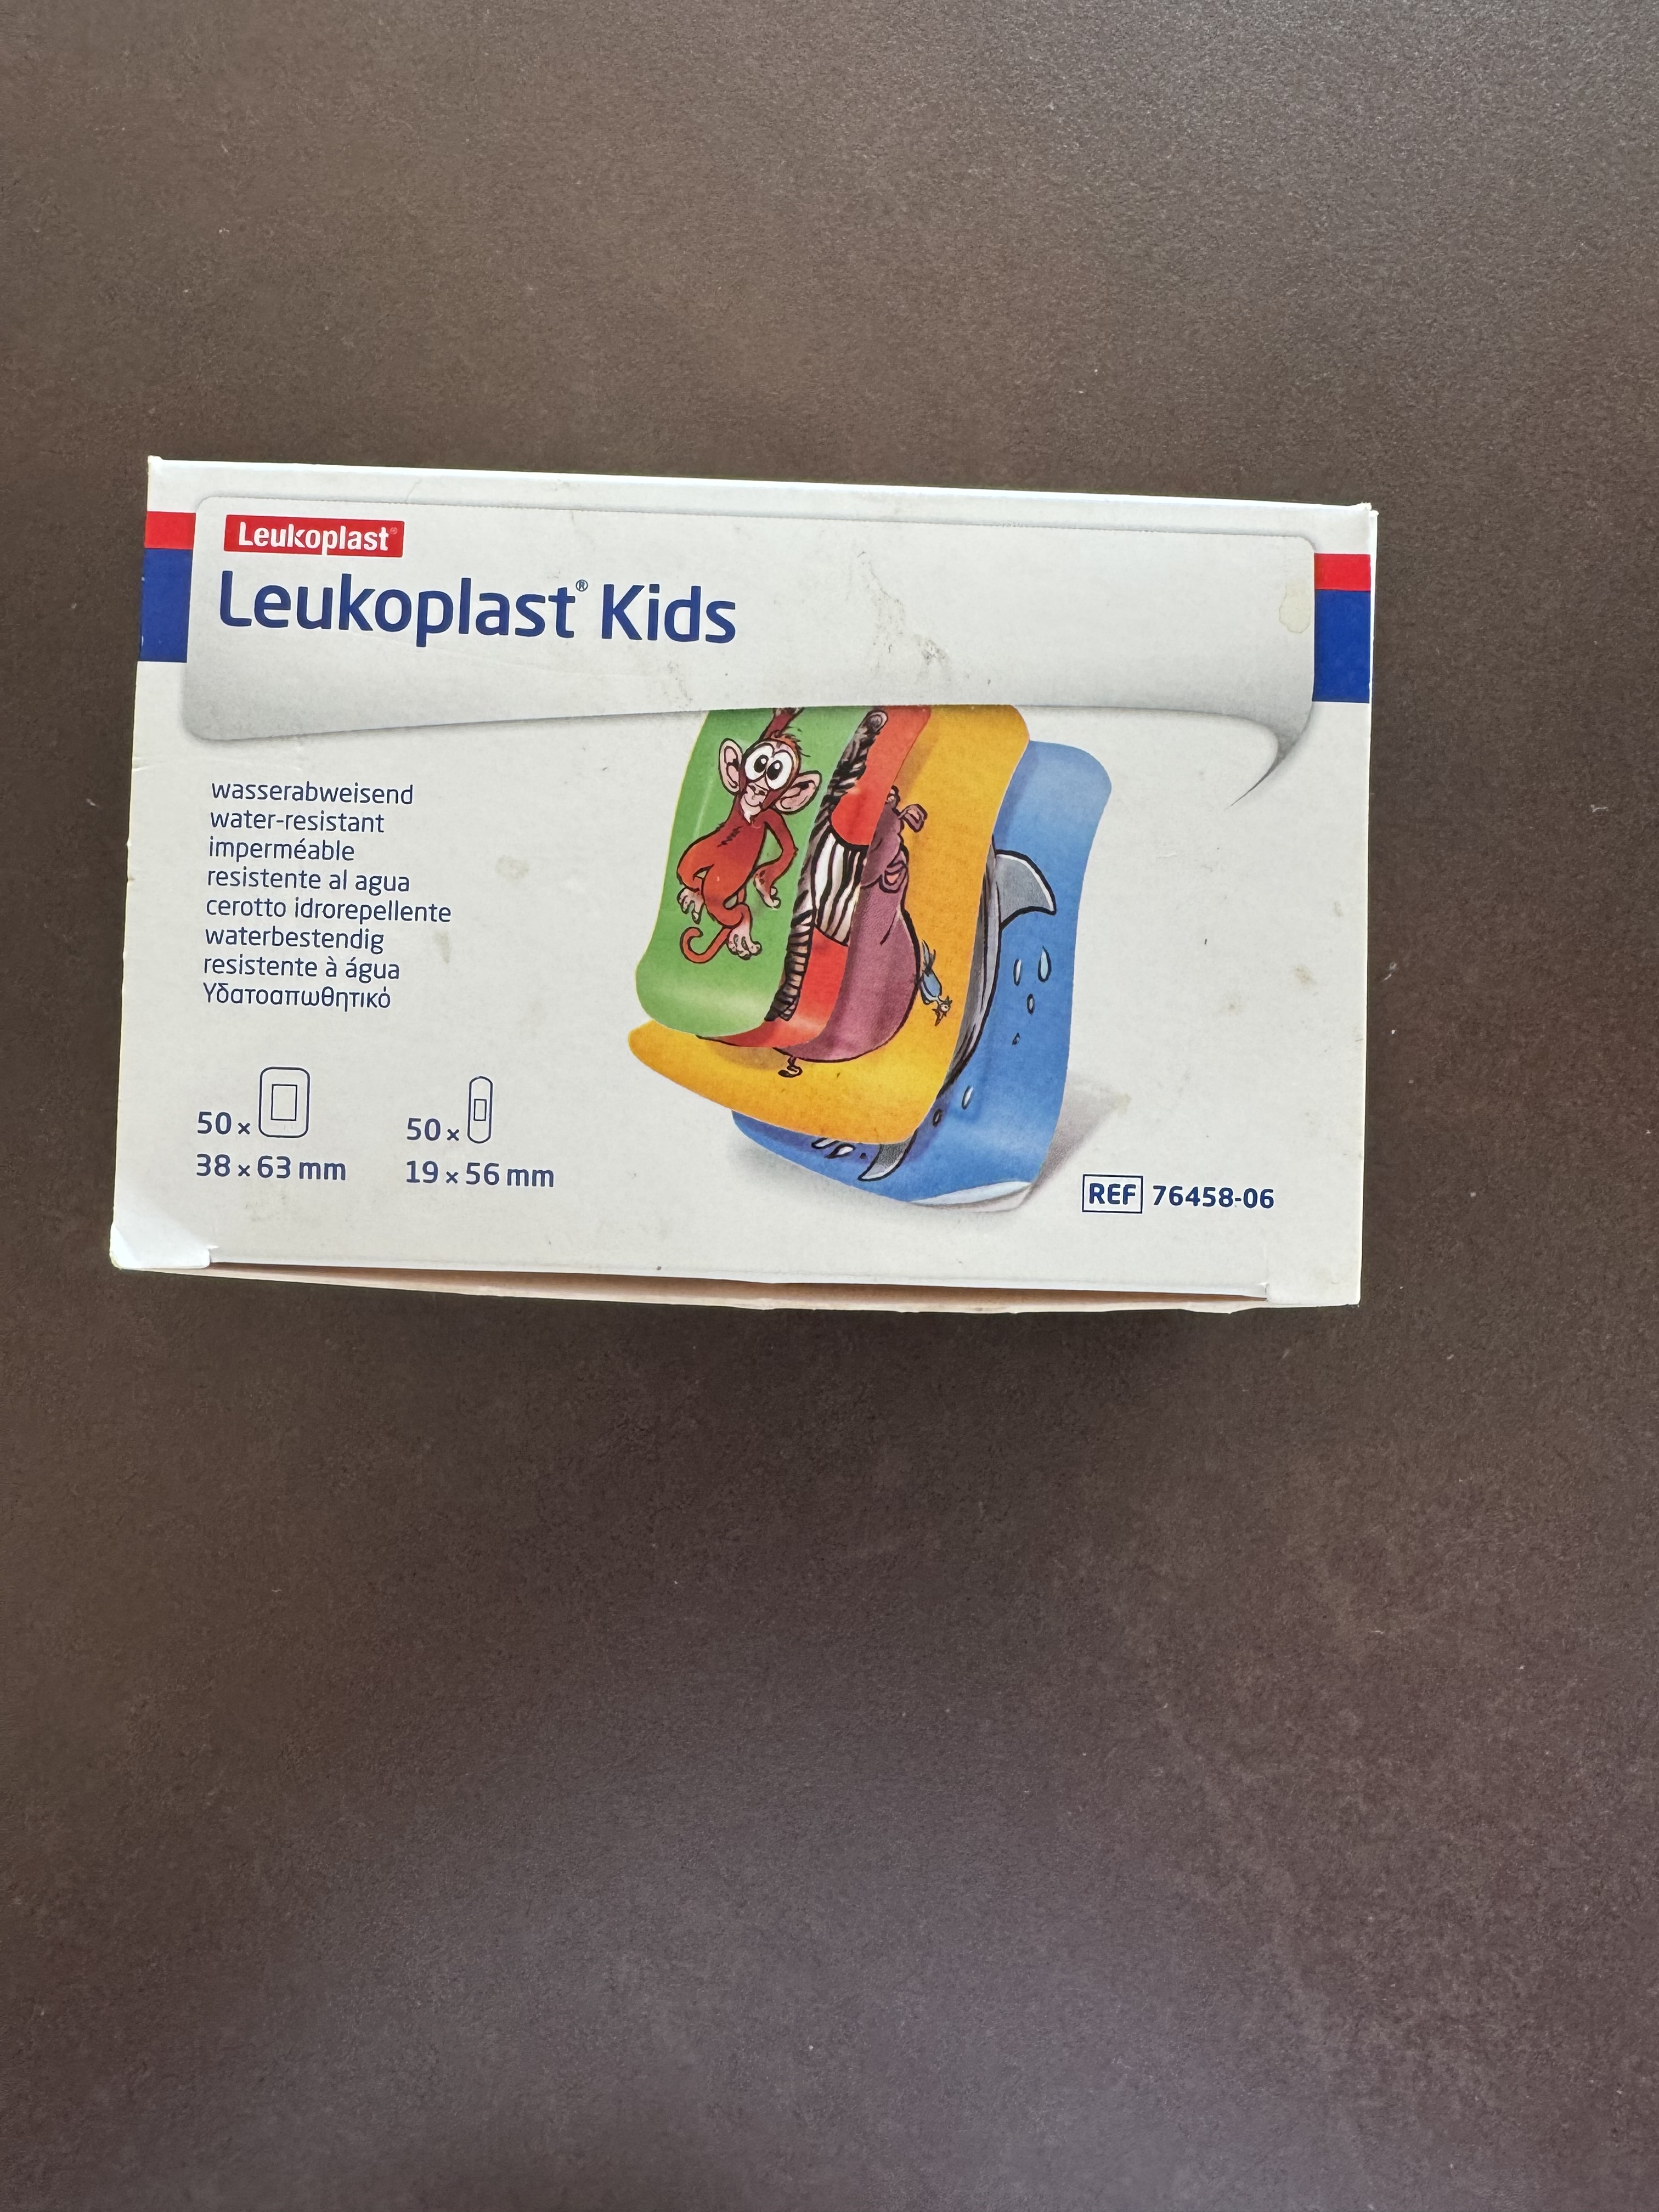
Product 360º

Slide 16
Product / Service example of KPIs
Is to have the right Product and/or Service offer to cover the consumer needs.
Product
Superiority
Innovation Rate
Price Index
Net Sales
Gross Profit

Slide 17
Brand Building Principles
Visible
Distinctive
Consistent
Superior

Slide 18
To grow - Set Targets and Track
Assessment
Diagnostic
Set Targets
Track Short Term
Track Long Term
Physical Availability
Distribution WD % vs Category
Distribution WD SKU Actuals
Share of Shelf Physical
Share of Shelf Digital
Channel Predence Physical
Channel Predence Digital
Mental Availability
Top of Mind
Aided Awareness
Media Spend
Comms Quality / Link Score
Total Reach & Total Reach +1
Total Working A&P
Working Media & of A&P
Weeks on Air
Share of Voice
Share of Search
TBCA
Planning
Process
Product
Superiority
Innovation Rate
Price Index
Net Sales
Gross Profit

Slide 19


