Slide 1

WELCOME!
We are happy to see you at our event!
Questions? Get in Touch: Tel: +44 20 3884 3050, Mobile/WhatsApp: +44 7967824023, enquiries@lynx2market.com

Slide 2
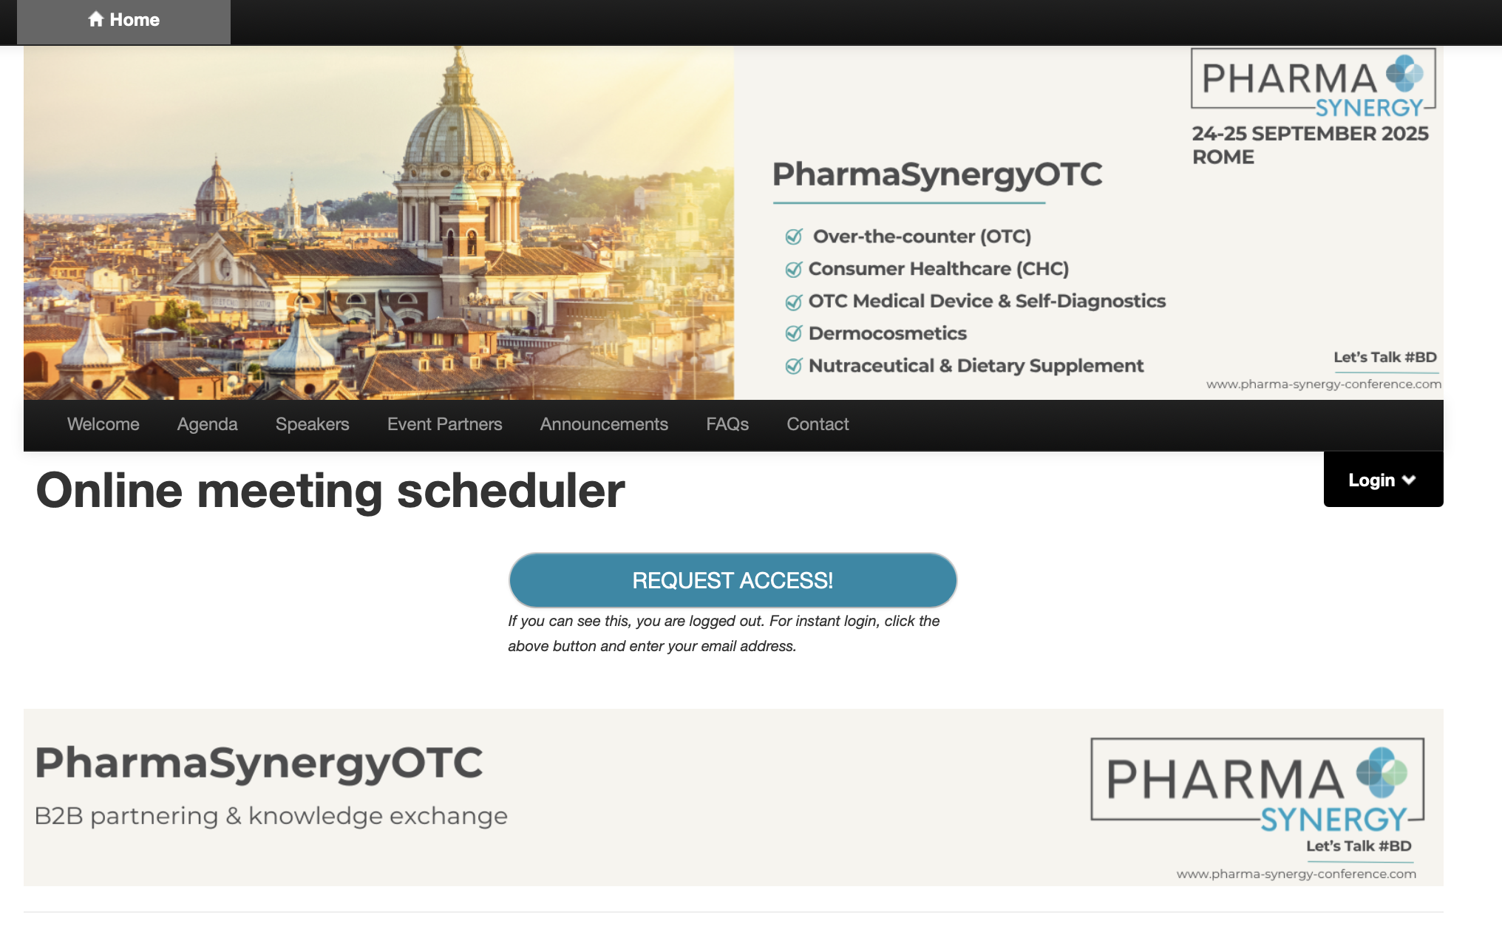
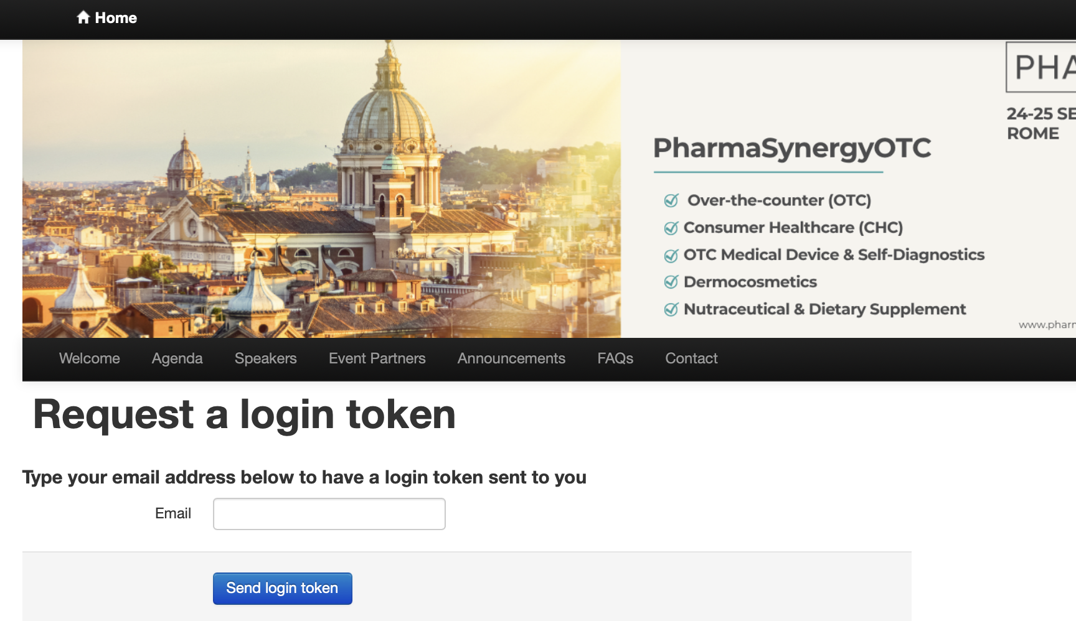
HOW TO LOG-IN
Follow the link on the PharmaSynergy website to access the platform.
Log in with the email address you used for registration.
When prompted, enter your email and leave the password field blank. An access token will be sent to your email.
If you don’t receive the access link, click Reset Password.
Questions? Get in Touch: Tel: +44 20 3884 3050, Mobile/WhatsApp: +44 7967824023, enquiries@lynx2market.com

Slide 3
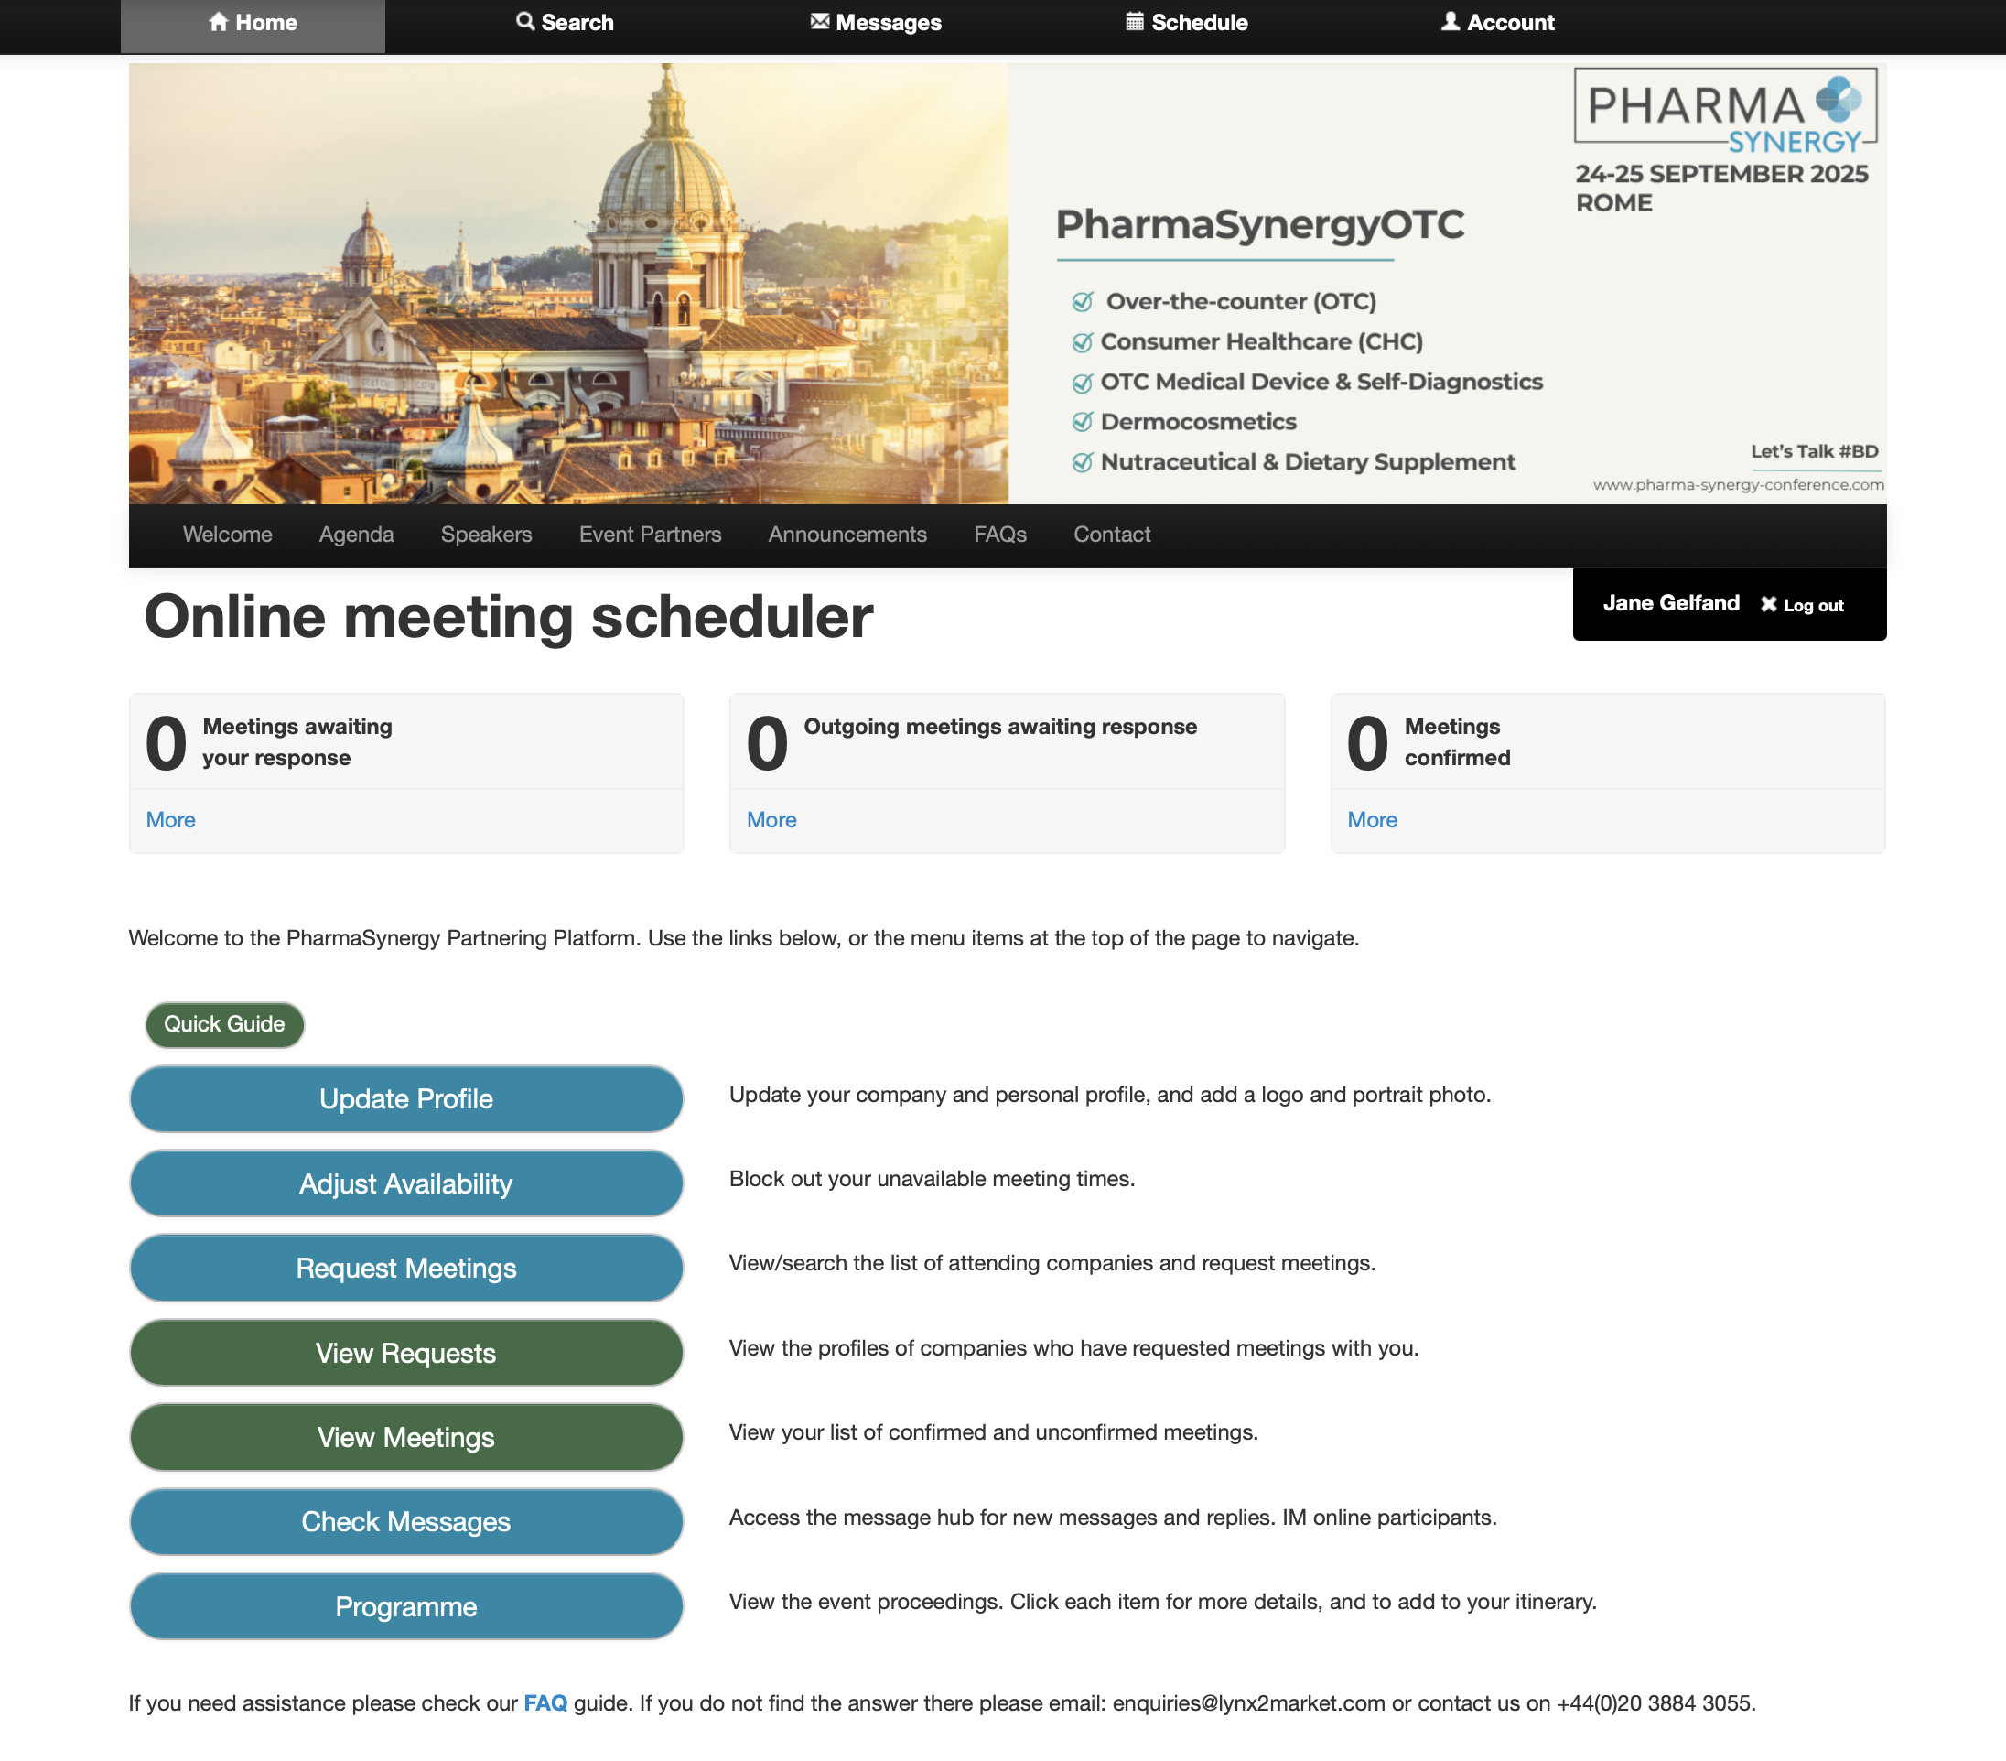
HOME PAGE
Your Home page provides quick links and a snapshot of your meeting status, making platform navigation simple and intuitive.
Questions? Get in Touch: Tel: +44 20 3884 3050, Mobile/WhatsApp: +44 7967824023, enquiries@lynx2market.com

Slide 4
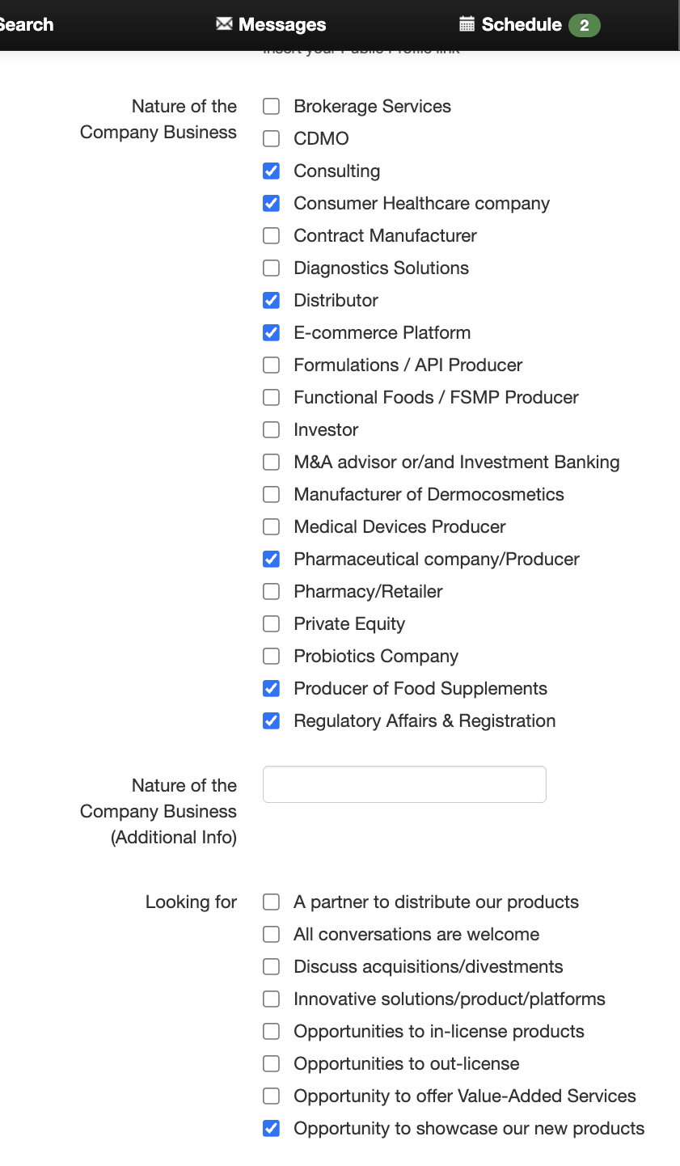
CHECK AND UPDATE YOUR PROFILE
IMPORTANT! Start by selecting the Account tab and ensure your profile information is accurate. This information helps others find you on the platform.
Questions? Get in Touch: Tel: +44 20 3884 3050, Mobile/WhatsApp: +44 7967824023, enquiries@lynx2market.com

Slide 5
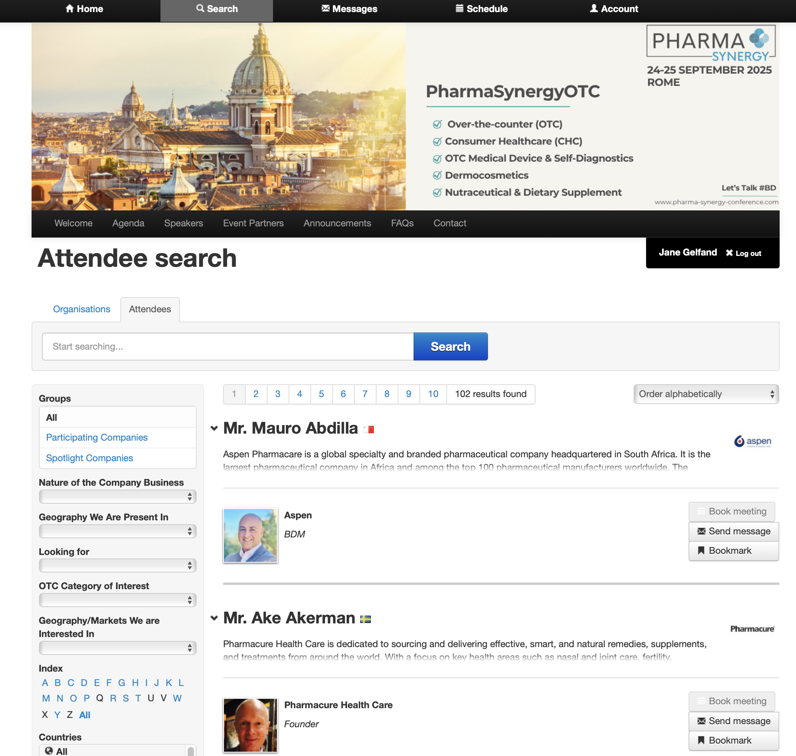
SEARCH FOR PARTNERS
To find potential partners (companies or attendees), click Search. You can search by:
Organisation or Person’s Name
Alphabetical or by join date
Filters
You can also bookmark companies/people of interest.
Questions? Get in Touch: Tel: +44 20 3884 3050, Mobile/WhatsApp: +44 7967824023, enquiries@lynx2market.com

Slide 6
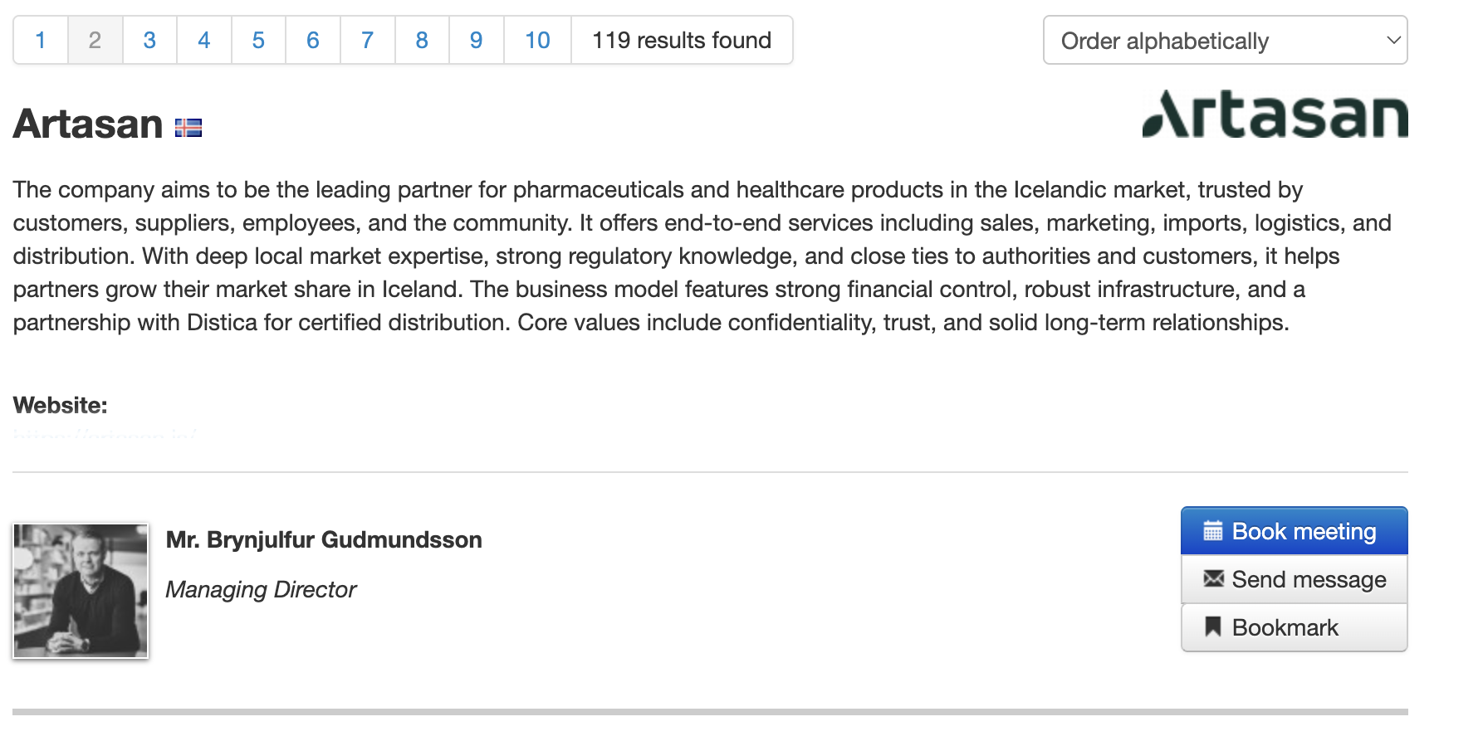
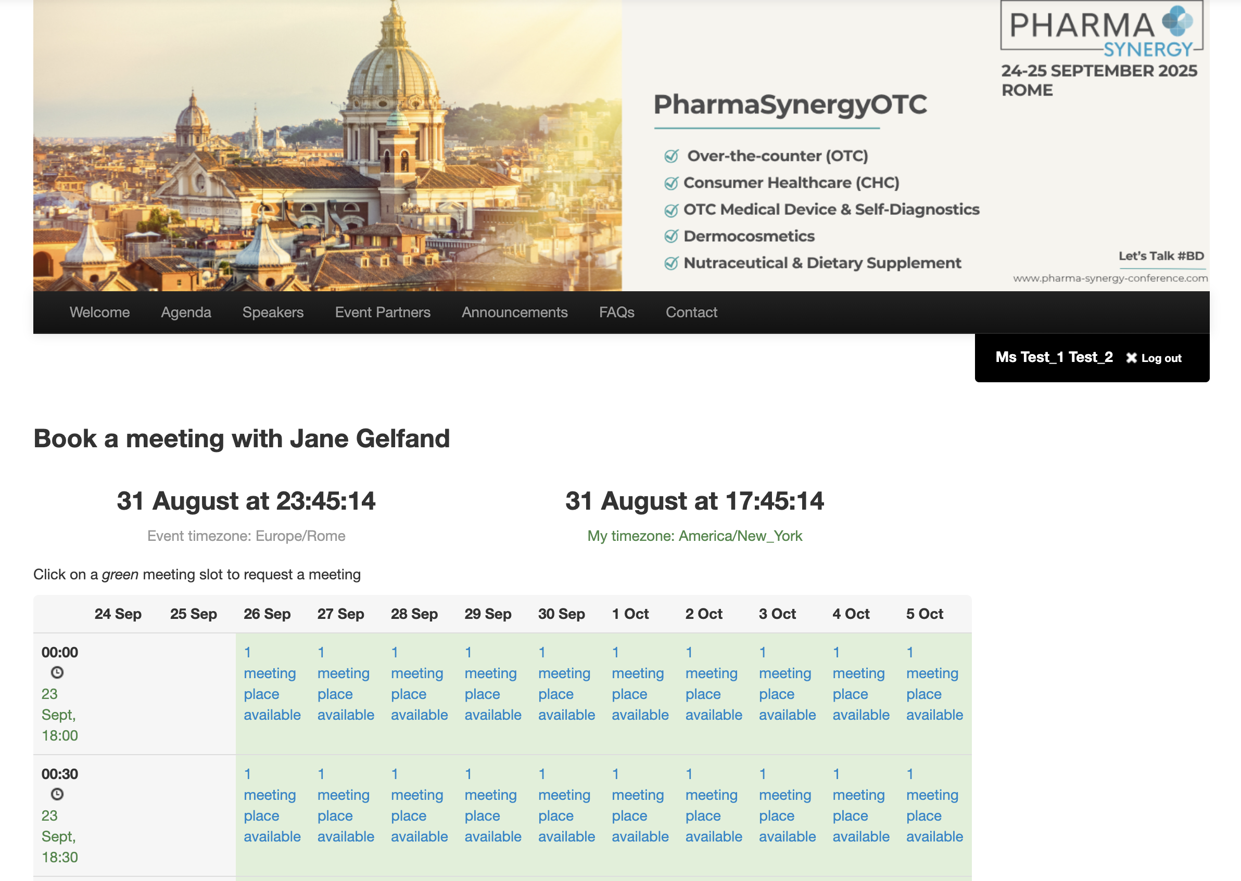
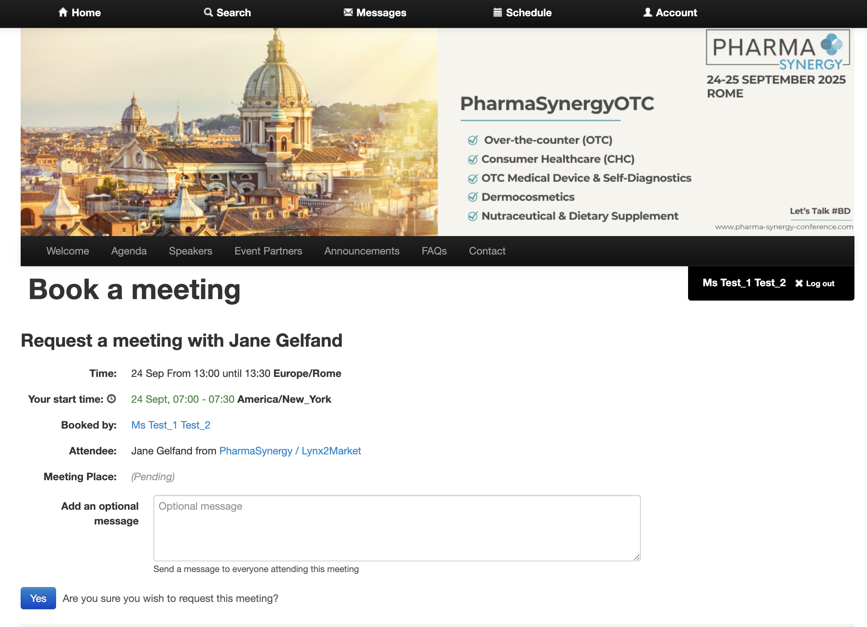
REQUEST MEETINGS
To request a meeting, click Book Meeting next to the person’s name. Available slots will appear in your calendar.
Please check time zones before booking.
Questions? Get in Touch: Tel: +44 20 3884 3050, Mobile/WhatsApp: +44 7967824023, enquiries@lynx2market.com

Slide 7
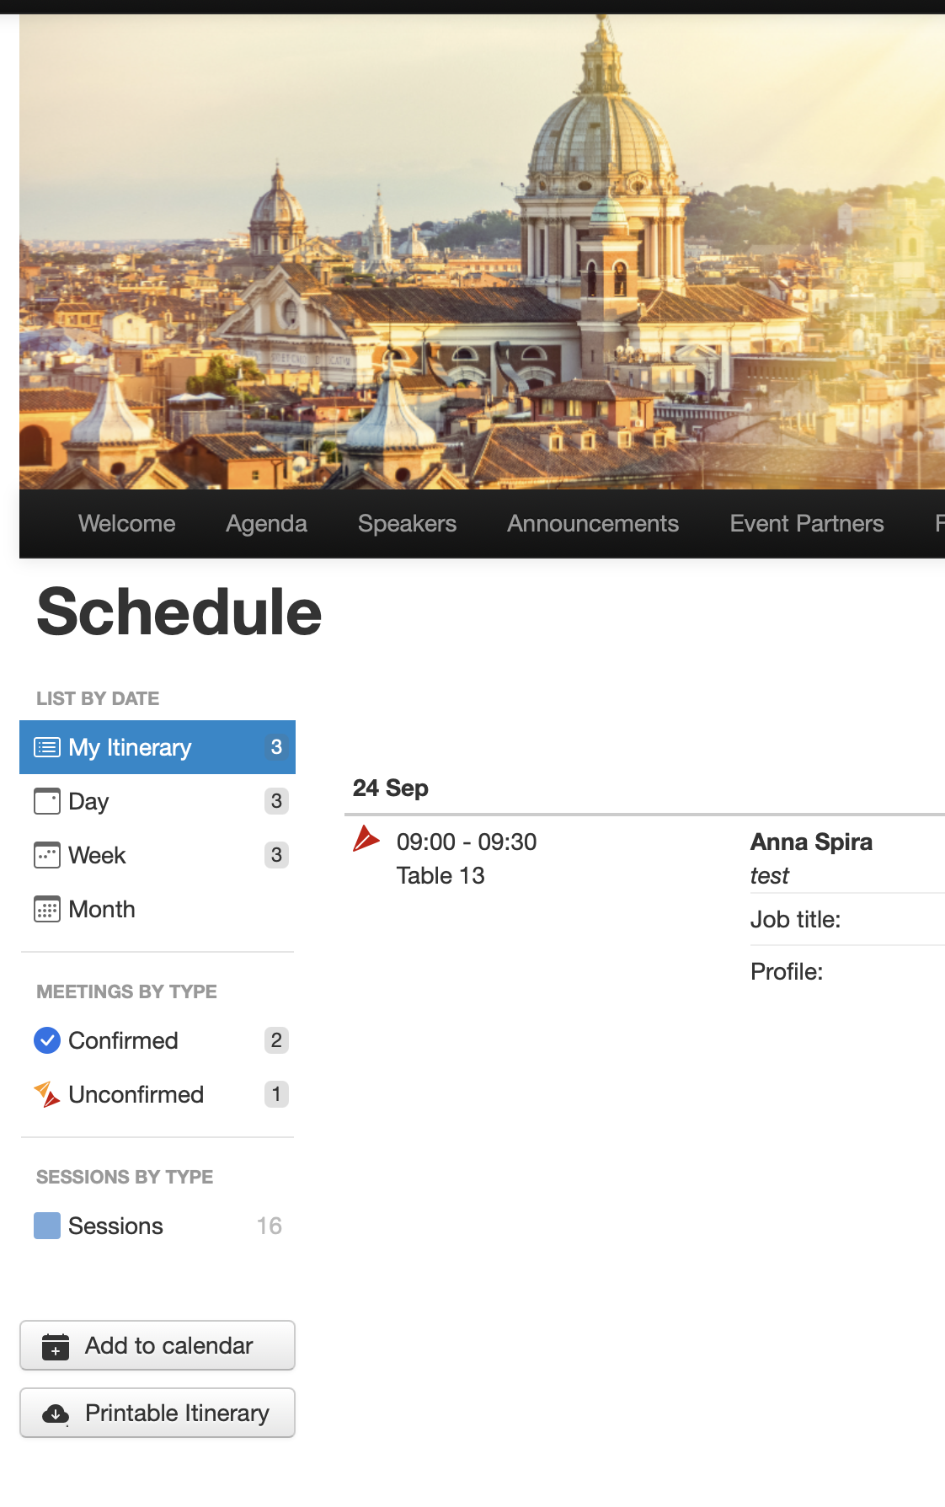
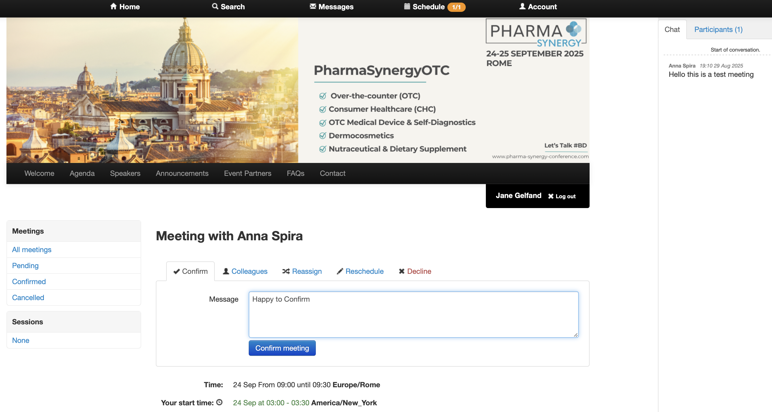
CONFIRM OR DECLINE MEETINGS
To accept, decline, reschedule, or add a colleague to your meeting, go to the Schedule tab.
Click on Meetings (by Type)
Select an individual meeting and click on it to confirm, decline, reschedule, add a colleague, or reassign.
Note that Chat can be used and will appear on your right
To return to your calendar, click Schedule.
Questions? Get in Touch: Tel: +44 20 3884 3050, Mobile/WhatsApp: +44 7967824023, enquiries@lynx2market.com

Slide 8
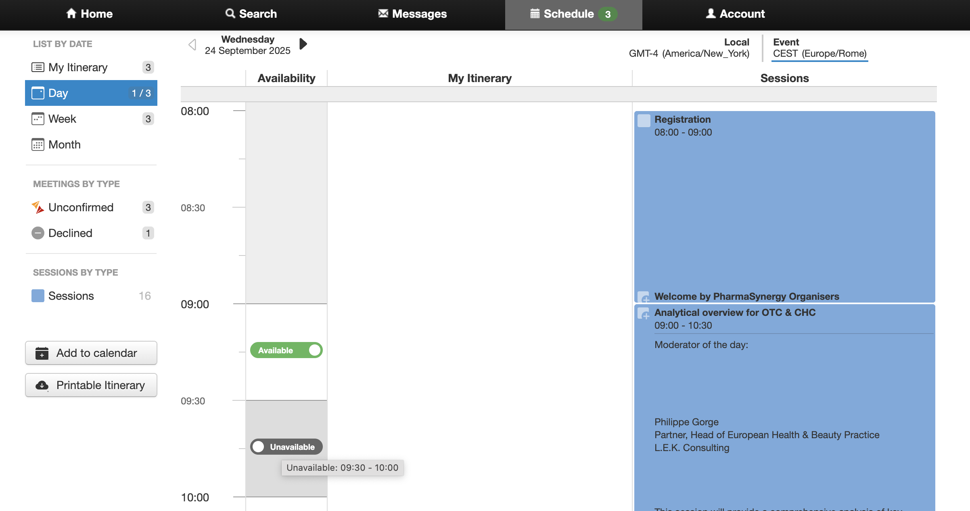
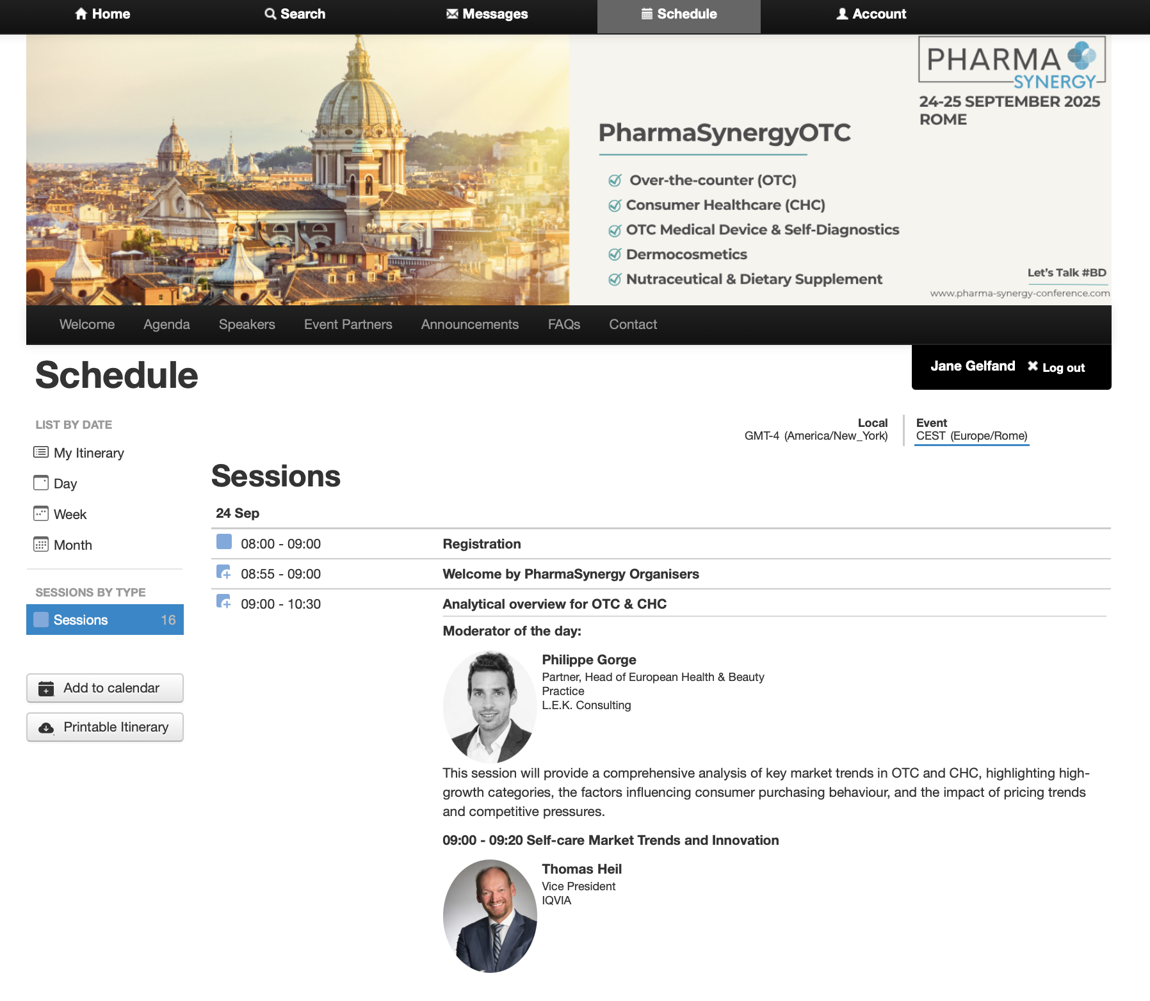
ADD TO WORK CALENDAR
To align meetings/sessions with your work calendar, please click Schedule, scroll down, and then click Add to calendar.
Questions? Get in Touch: Tel: +44 20 3884 3050, Mobile/WhatsApp: +44 7967824023, enquiries@lynx2market.com

Slide 9
SCHEDULE TAB
To view your full itinerary, including confirmed/declined meetings, booked sessions, and to block times in your calendar press Schedule.
To block/unblock times slots in your calendar, click on Available/Unavailable button.

Slide 10
SESSIONS & PRESENTATIONS
To attend a session, block the time in your schedule (you can unblock it later).
To add a session:
Go to the Schedule tab.
Select Sessions and choose one of interest.
Click the + icon to add it to your schedule.
Questions? Get in Touch: Tel: +44 20 3884 3050, Mobile/WhatsApp: +44 7967824023, enquiries@lynx2market.com

Slide 11
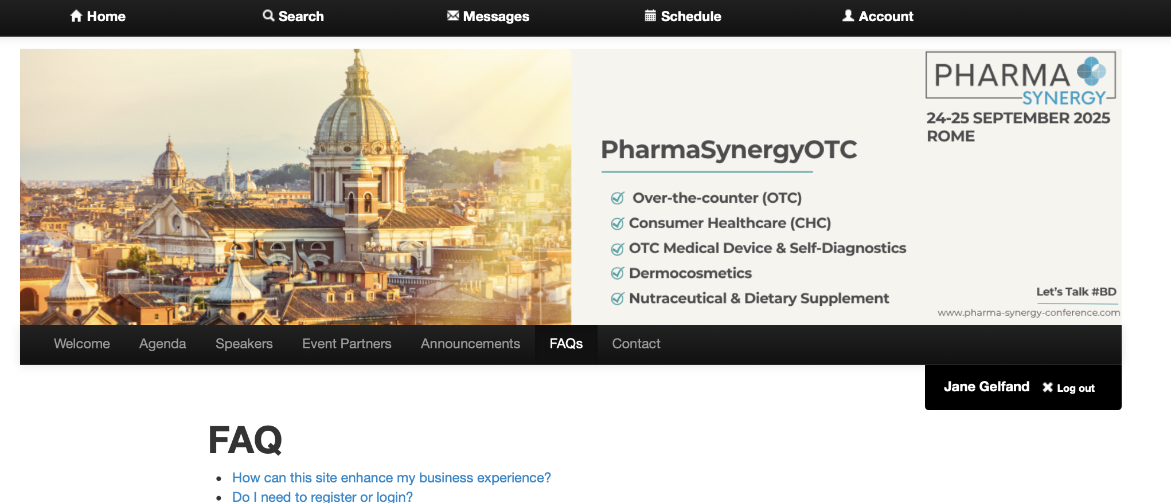
HELP WITH THE PLATFORM
Please pay attention to the important menu tab “FAQs” that contains additional tips about navigating the platform.
Questions? Get in Touch: Tel: +44 20 3884 3050, Mobile/WhatsApp: +44 7967824023, enquiries@lynx2market.com

Slide 12
NEED TO GET IN TOUCH?
If you can not sign in, access your profile, have difficulty in navigating the platform or need to talk to us, please let us know.
Telephone: +44(0)20 3884 3055
E-mail: enquiries@lynx2market.com
We will make every effort to get back to you as soon as we can.
If you need our attention immediately, please
E-mail: yricci@lynx2market.com
Get in touch: Mobile: +44 7967824023 (WhatsApp)

